Slide 1
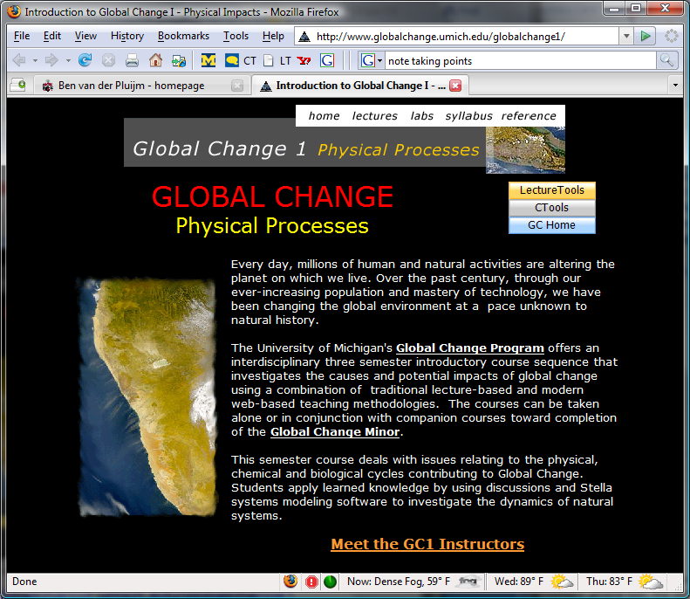
Global Change 1: Physical Processes
Environ 110 Biol 110 Earth 171 AOSS 171 ENSCEN 171
1
www.globalchange.umich.edu/
Notes:
1
If you weren’t here the first day, welcome to Global Change 1. I’m George Kling, the lead instructor of the course. This is part of a sequence of courses and a University Minor – Cross-listed as many different course numbers – makes no difference to you. Today we have two goals (pick up where we left off after the first lecture…). First, we want ensure that all of you are comfortable with the Ctools and LectureTools learning environment, Second we want to assess your current understanding of some of the key issues we will address, to help us better understand how to teach the material.

Slide 2
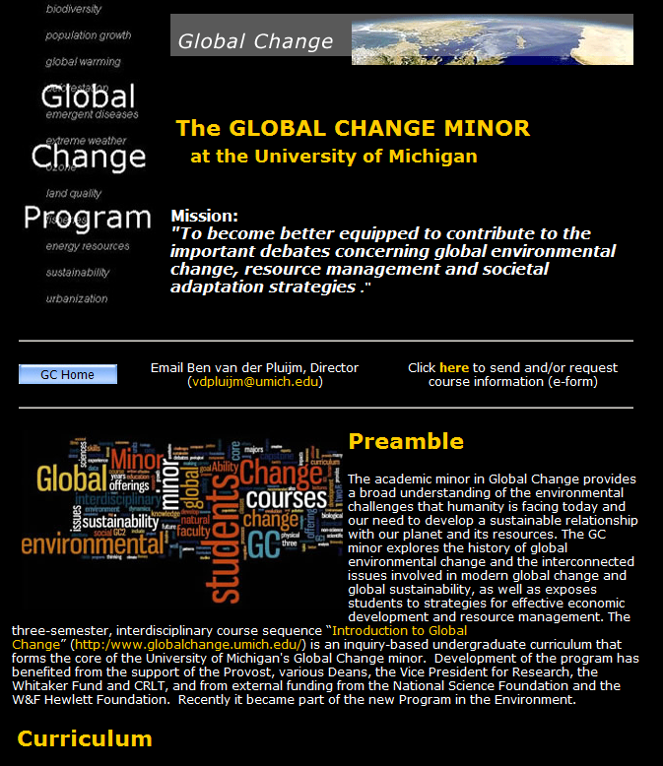
2

Slide 3
The GC2 Wheel of Lectures (Winter Semester)
Sustainability
Transdisciplinarity
Systems Thinking
GLOBAL CHANGE
Roadmaps
Systems and
Sustainability
Adaptation
to Appropria-tion
of Nature
Colonialism to modern
Resource Depletion
Climate
Change:
Mechanisms
And Impacts
Biodiversity
Conservation
Global
Connectivity
And Density
Global
Health
Velocity,
Scarcity
Inequality,
Extremity
How to read this slide: Clockwise from the “midnight” position:
1) First three basic Conceptual & Chronological Units preparing us to think about broad issues of past, present and future
2) The heart of the course is four theme-driven modules on relatively recent past and present issues: colonialism, energy, climate, and conservation
3) We conclude with a future-oriented series of lectures on global trends, including health
Energy past,
Present,
and policy
Notes:
3
Faculty, not wheel spins

Slide 4

Wrapping up
Global Change encompasses all the ways that our planet has been changing since its formation ~4.5 billion years ago to today, and looking toward the future.
Humans are affecting Earth and its life support systems at an unprecedented rate, which poses new challenges to humankind and our planet.
Decisions and good policy require good science.
…. that is why you are in Global Change !
Notes:
Ask if this roadmap has helped people to understand where the class is headed and what to expect. Ask who thinks it hasn’t helped, or is still “complicated”. There will be some, and that is to be expected because there are 3 professors and the downside is that each one has a different style. But the upside is that you will never get this experience again with 3 profs in one class, and in fact this is probably the best way of doing it because you sort of get the “best of” album from each of them. Face it, most profs don’t have enough insight about the world to last a full semester –
(I’ve given you all my secrets just today, in one class! Sure there is more depth in all of it, but, the general tools that I use in my professional life you now know. It is relatively simple, really, and yet it has kept me in beer and chips for quite a while…)

Slide 5
The Criteria of Solid Reasoning
1. Clarity
2. Accuracy – is the statement true?
3. Precision
  “information” – being precise, giving necessary details
  “scientific” – precision or “error” – HOW accurate?
4. Relevance – how is a statement used in an argument?
5. Logic
  a series of statements that are mutually reinforcing, not contradictory
6. Breadth and Depth
  Assumptions (statements accepted as true without proof)
  Complexities and other points of view
  Realistic solutions
ALL = “EVIDENCE”
Adapted from McConnell and Abel 2002
Notes:
Clarity -- this is the “gateway standard” of critical thinking, meaning that it is the most important. If you are not clear in the beginning, nothing can follow. “what is going on with pollution?” versus “how can citizens and policy makers insure that toxic emissions from industry don’t cause ecological damage or harm human health?”
Accuracy – Is the statement true? How can we find out? A statement may be clear, but not true. “I believe all students in the state of Michigan are below average” – clear but not true.
Precision – two meanings. In general with information it means being precise, giving enough details to evaluate the statement. If we said “there are more SUVs in the U.S. now than every before”, that statement is clear, it is accurate, but it isn’t very precise – how many more? 1, 1000, a million? For a scientist, precision is a measure of the “error” in a statement or number – not all statements have absolute accuracy, in fact most don’t and they need a “ qualifier” in order for us to assess HOW accurate the statement is. If we predict the temperature will increase by 5 degrees Celsius by the end of the century, it makes a difference what the error bounds or precision is in that prediction – if we say it is plus or minus 2 C, then it could increase by 3 or 7 C. But if the precision is plus or minus 5 degrees, it means that there might be no change at all, or it could warm by 10 C. The greater the precision, the lower the error, and the more confidence we have in the accuracy of any statement.
Relevance – how is a statement used in the argument? Let’s say that we have the responsibility of reducing toxic pollution by an industrial plant. In the public comment period one of the plant owners states that “this plant provides 1,000 jobs in this state alone”. That is a clear statement, it was accurate and precise, but it was not relevant to the task of reducing pollution.
Logic – “a series of statements that are internally consistent, without contradictions”. If I say that to get an A in this class you need to attend lecture and pay attention, attend labs and do the assignments, but don’t study for the exams, you can spot right away the contradiction in the argument.
Breadth and Depth – one big key here is the “assumptions” that are present in nearly all statements and arguments. E.g., if I say “this class is not difficult”, what are my underlying assumptions? I assume that you will come to lecture and pay attention, you will go to all the labs and complete the lab assignments, and that you will review and study for the exams. That is a lot of assumptions. You can have ALL OF THE ABOVE (clarity, accuracy, precision, relevance, and even logic) and still miss the boat because of assumptions. Let me use the same example – my recipe for success in this class is clear and logical, but, my assumption is that you want to do well in the course and get a good grade. If you only want to get a D, then my argument, my reasoning, is wrong or irrelevant.
Finally consider the realism of a solution – the classic example is the response of one presidential administration to the problem of drugs in society, which was “just say no”. Really? Come on, does that cover the complexities of the situation? It is not realistic.
All of these criteria need to be used as “evidence” to support your reasoning, to support an argument. And in this class we will help you to practice this kind of reasoning while learning about global change

Slide 6
Tips for Learning
1. Read the Web Notes Before Class
2. Take Notes During Class
Listen for “signal statements”, e.g., “…the most important point is…”
Write with abbreviated words and symbols – write short sentences
Place a question mark (?) next to material you don’t understand, or, raise your hand and ask a question.
3. Rewrite Your Notes After Class – The Same Day!
Make your notes more complete by expanding abbreviations and writing longer sentences. Add points that you might remember but that you didn’t write down.
Make your notes more accurate by answering questions you had when writing your notes in class. Read the web notes for that lecture, talk to fellow students, or ask your GSI or instructor.
4. Take the “self-test” for each Lecture to reinforce the information.
Get organized,
Manage your Time!

Slide 7
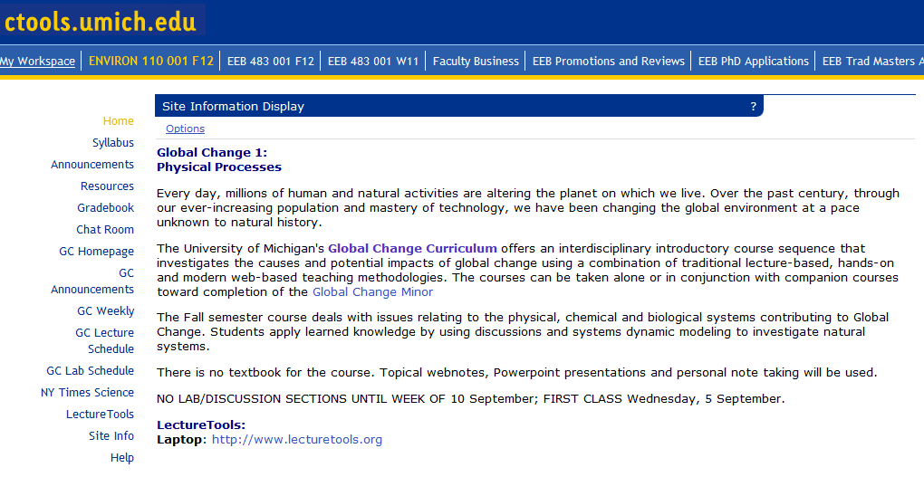
Course Management: U-M’s Ctools
https://ctools.umich.edu/
7
Notes:
7

Slide 8
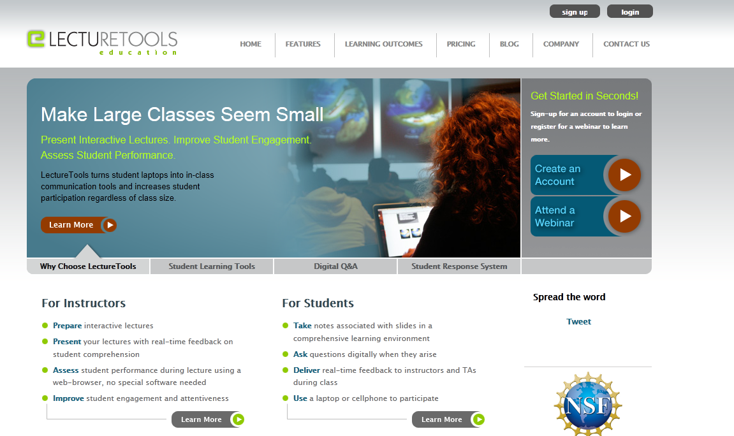
Sign into ctools at ctools.umich.edu/
Choose your course tab for ENV 110 (or the # you registered)
Click on LectureTools at bottom left
Choose “enter LectureTools”
Fill in the required fields for registration
You will automatically be added to LectureTools
Notes:
2. Click on ‘Student Registration’
3. Enter “481” as the zip code (upper right)
4. Choose ‘University of Michigan – Ann Arbor’ as the school
5. Select “Fall” and then this course from the drop-down menus
Our course is the 3rd one listed
6. Fill in your name and choose a password, then click on “register”

Slide 9
Where are you from?

Slide 10
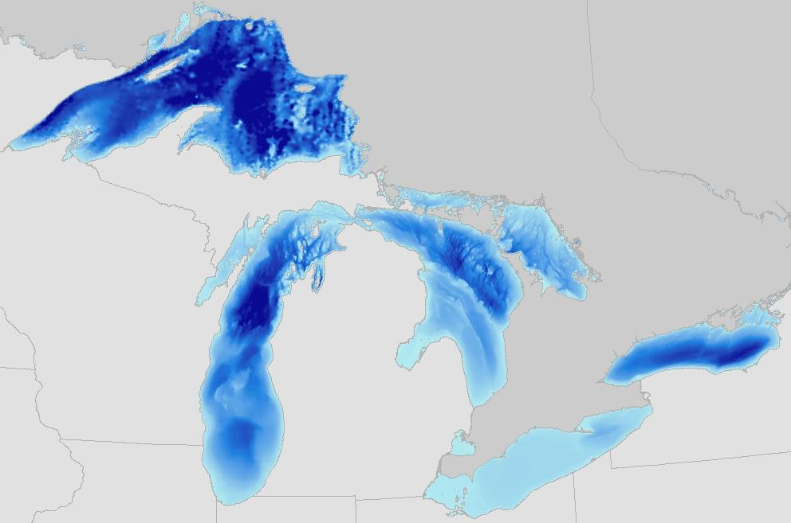
Where is the Mackinac bridge?

Slide 11
Which of the following best describes your views about the relationship between species and the tree of life?
Species are unmodified since their original creation by divine intervention, as is the entire tree of life.
Species can adapt and change in minor ways, but are still recognizably the same as their original form, and so speciation does not explain the tree and diversity of life.
Speciation by natural selection over the history of life has given rise to increasingly complex organisms, with clear intermediate forms, and this basic branching process extended over Earth’s history explains the biodiversity and tree of life we see today.

Slide 12
Teaching about Evolution
Evolution by natural selection is an important scientific idea and should be required material in biology courses in high school and college.
Evolution is only one theory of the origin of life, and should be taught together with other potential explanations such as intelligent design.
Intelligent design cannot be tested scientifically and should not get equal time with evolution in science classes.
Biological evolution is too uncertain and too controversial to be part of a required curriculum in high school but can be required in college.

Slide 13
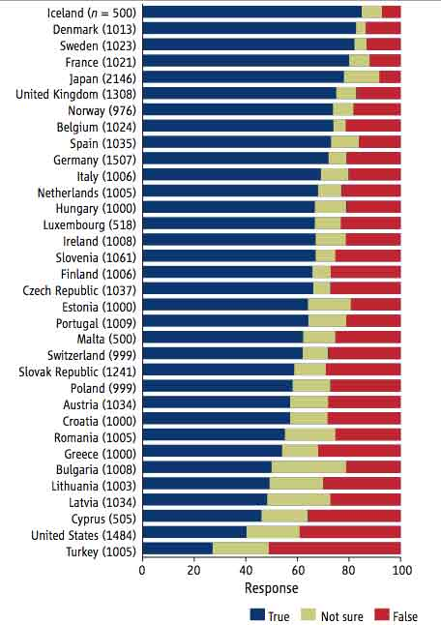
Public Acceptance of Evolution
“Human beings, as we know them, developed from earlier species of animals.”
True or false?
Miller JD, Scott EC, Okamoto, S (2006) Public acceptance of evolution. Science 313:765-766.
Based on surveys of 34 countries taken since 1985

Slide 14
Global Climate Change
Climate warming may be occurring, but there is much uncertainty about whether humans are responsible or changes are simply due to natural variation.
Climate warming is probably occurring, but the contribution of humans is still uncertain and may not be substantial.
The vast majority of scientists agree that climate warming is occurring and that humans are largely responsible.
Scientists promote the idea that climate change is occurring in order to maintain research funding for their work.

Slide 15
Global Environmental Change
Global environmental change encompasses many issues. Rank the following from greatest (1) to least (4) in importance.
  Sustainable food supply
  Sustainable water supply
  Global Warming
  Biodiversity loss

Slide 16
Global Environmental Change
Global environmental change encompasses many issues. Using the open-ended question tool in LectureTools, provide a free-form answer of the issue that concerns you the most.
Example: “I am most concerned about the melting of arctic ice”

Slide 17
Explorations
What does it mean to “know” something?
  I “know” that climate change is a serious threat to our futures – but what is the basis for my knowledge?
What do citizens of the U.S., or students at a major University, know of global change issues? And how can we instructors be most helpful in communicating the relevant science?
  Please help us by answering a series of questions to the best of your ability

