Slide 1
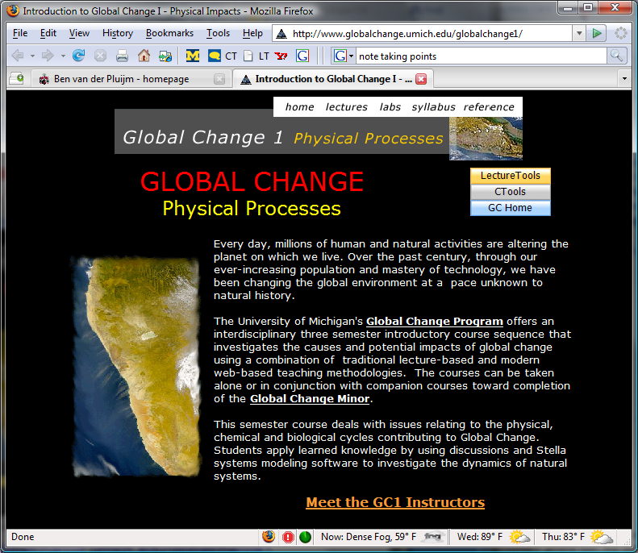
Global Change 1: Physical Processes
Environ 110 Biol 110 EARTH 171 AOSS 171 ENSCEN 171
www.globalchange.umich.edu/
Notes:
- Welcome to Global Change 1. I’m George Kling, the lead instructor of the course.
- This is part of a sequence of courses and a University Minor – how many have taken GC2?
- Cross-listed as many different course numbers – makes no difference to you.
- There is still room in the course, and at the end of class today we will have time to help people figure out which lab section they can get into – so, don’t worry, we will get you into the course (including seniors).
- Several things to do today:
- First is to introduce this team-taught, interdisciplinary course and give an overview of the class and its goals.
- Second is to go over some of the nuts and bolts of the course.
- Third is to have each faculty member preview themselves and the topics that they will be teaching.
- Finally is to introduce the GSIs and talk to them if you need to change lab sections

Slide 2

Global Change 1: Introductions
Professors
Catherine Badgley
Department of Ecology and Evolutionary Biology; cbadgley@umich.edu
George Kling
Department of Ecology and Evolutionary Biology; Course Coordinator. gwk@umich.edu
Chris Poulsen
Department of Earth and Environmental Sciences, poulsen@umich.edu
Ben van der Pluijm
Department of Earth and Environmental Sciences, Program in the Environment.
Program Director for Academic Minor in Global Change; vdpluijm@umich.edu
GSI team
Jeff Shi, Ecology and Evolutionary Biology. email: jeffjshi@umich.edu
Louise Jeffrey, Earth and Environmental Sciences. email: louisej@umich.edu
David Rosier, School of Natural Resources and Environment. email: drosier@umich.edu
Meghan Taylor, Geology; email: taylorma@umich.edu
Support
Patrick Lau; globalchange@umich.edu
Email: globalchange@umich.edu
Notes:
There are 3 professors and the downside is that each one has a different style. But the upside is that you will likely never get this experience again with 3 profs in one class, and in fact this is probably the best way of doing it because you sort of get the “best of” album from each of them. Face it, most profs don’t have enough insight about the world to last a full semester…

Slide 3


Interdisciplinary, Team-taught
Natural and Social Science Curriculum
“To become better equipped to contribute to the important debates concerning global environmental change, resource management, and societal adaptation strategies.”
Science and understanding changes, we have to keep up!
3
Notes:
* Important to stay current with the world around us because it is changing rapidly – most change is in the science and technology side, and in our adaptation to changes in the natural world. Another way of saying that is “science is too important to be left to the scientists”.
* Consider for a second the case of Aristotle – he lived about two thousand three hundred years ago, and yet he could walk right into a modern seminar on campus on ethics, theology, moral philosophy, and he would be able to engage and contribute to the discussion. But if he walked into any science class, he’d be a lost soul – in fact each one of you could give Aristotle a tutorial on science and the natural world that would shock him, blow him away. It’s not because we are smarter than he was, it’s because science is “cumulative” – we live today with the benefit of Newton and Darwin and Einstein who have enabled us to have a much deeper understanding of the world than Aristotle ever could. And, my point here is that science and understanding are still changing, and we have to keep up! We don’t all need to BE scientists, but we must develop our skills and continuously practice the appreciation of science, to think just enough like a scientist to understand and contribute to the critical debates of global change, climate change, and how societies must adapt that are occurring all around us.

Slide 4
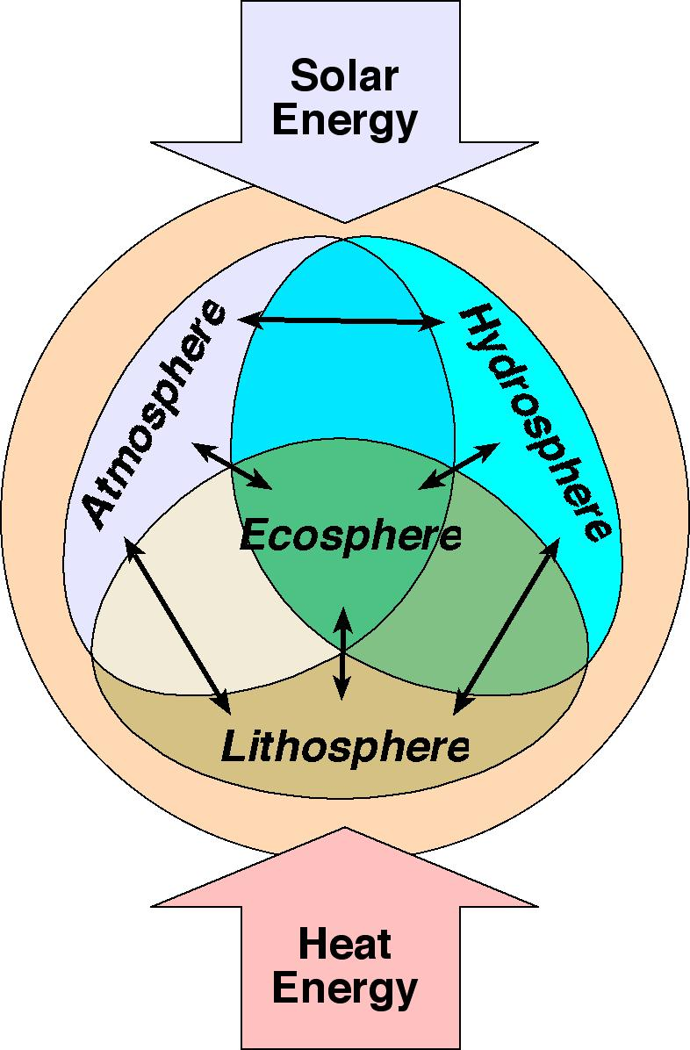
GC1 - Course Objectives
Understand Earth as an
“integrated system”:
Change and evolution (stars, solar systems, atmosphere, soils and life evolve from precursors)
Underlying physical and natural processes, how they work and how they are integrated
Variability and uncertainty (climate has always varied, prediction is difficult in complex systems)
Human alteration of Earth's physical and biological systems (rates are key)

Slide 5
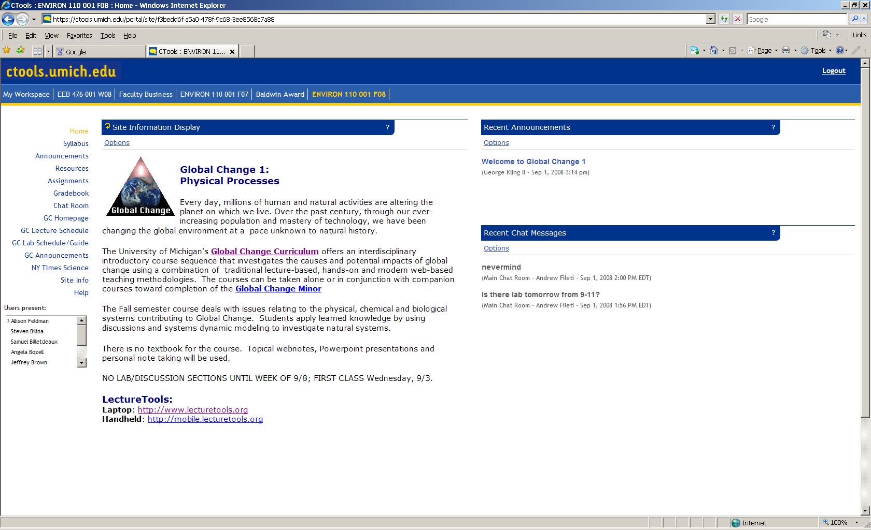
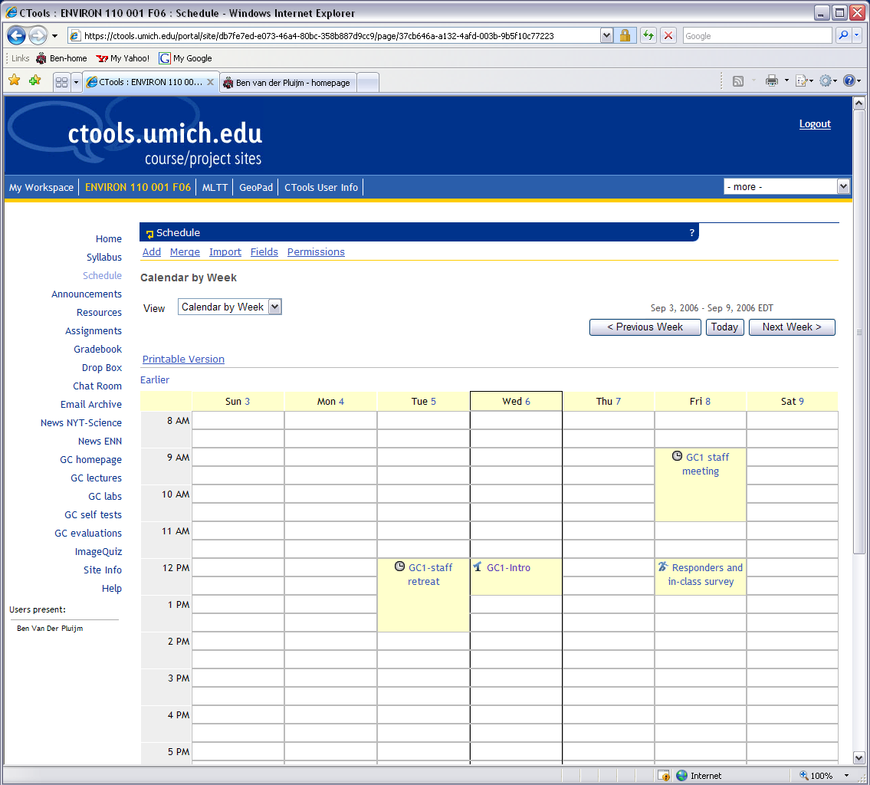
Course Management: U-M’s Ctools
https://ctools.umich.edu/
Notes:
How many people have not used Ctools before?
How many people are having trouble seeing our site on Ctools?

Slide 6
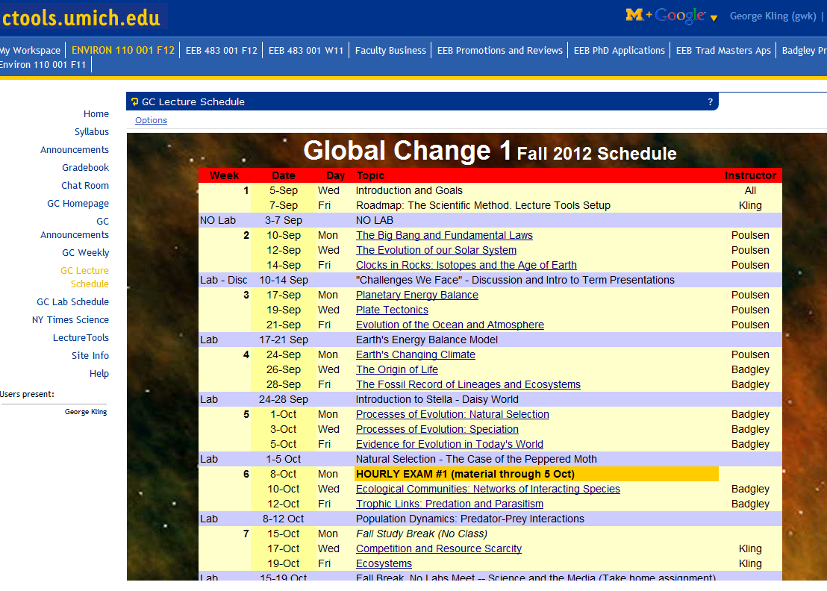
Lectures
Click on lecture title for web notes

Slide 7
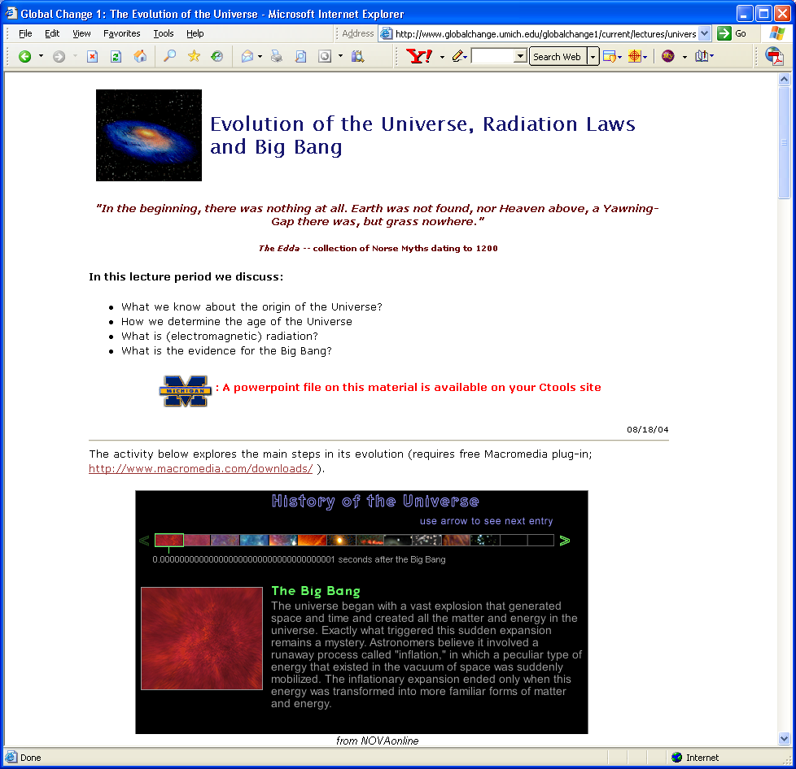
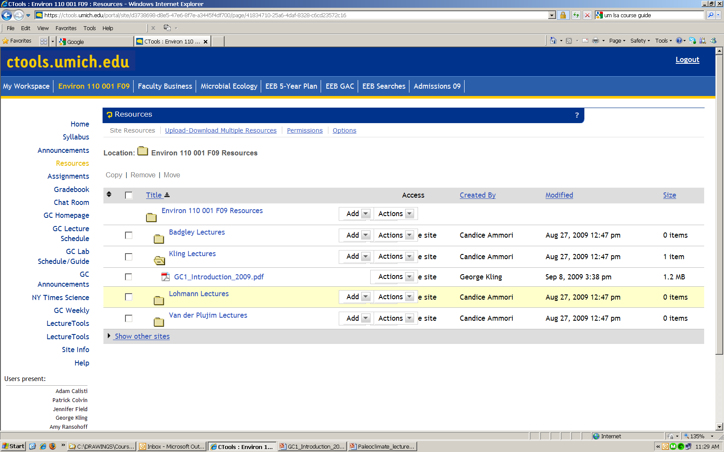
Lecture Notes and Lecture Slides
1. Your own class notes are important. Be here, so you learn more and won’t be surprised.
2. Supporting notes on-line (but they do not replace lectures).
3. Lecture Slides through Ctools and LectureTools (updated prior to lectures)

Slide 8
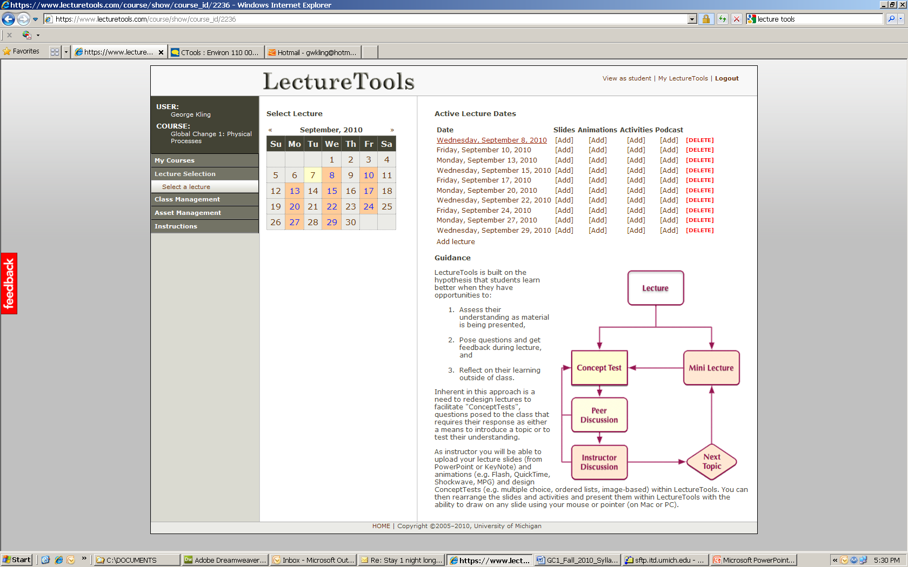
Information Environment (LectureTools)
Bring your wireless-enabled laptop to class for lecture notes, web access, and real-time searches
Details on Friday …
Notes:
How many people have used Lecture tools?

Slide 9

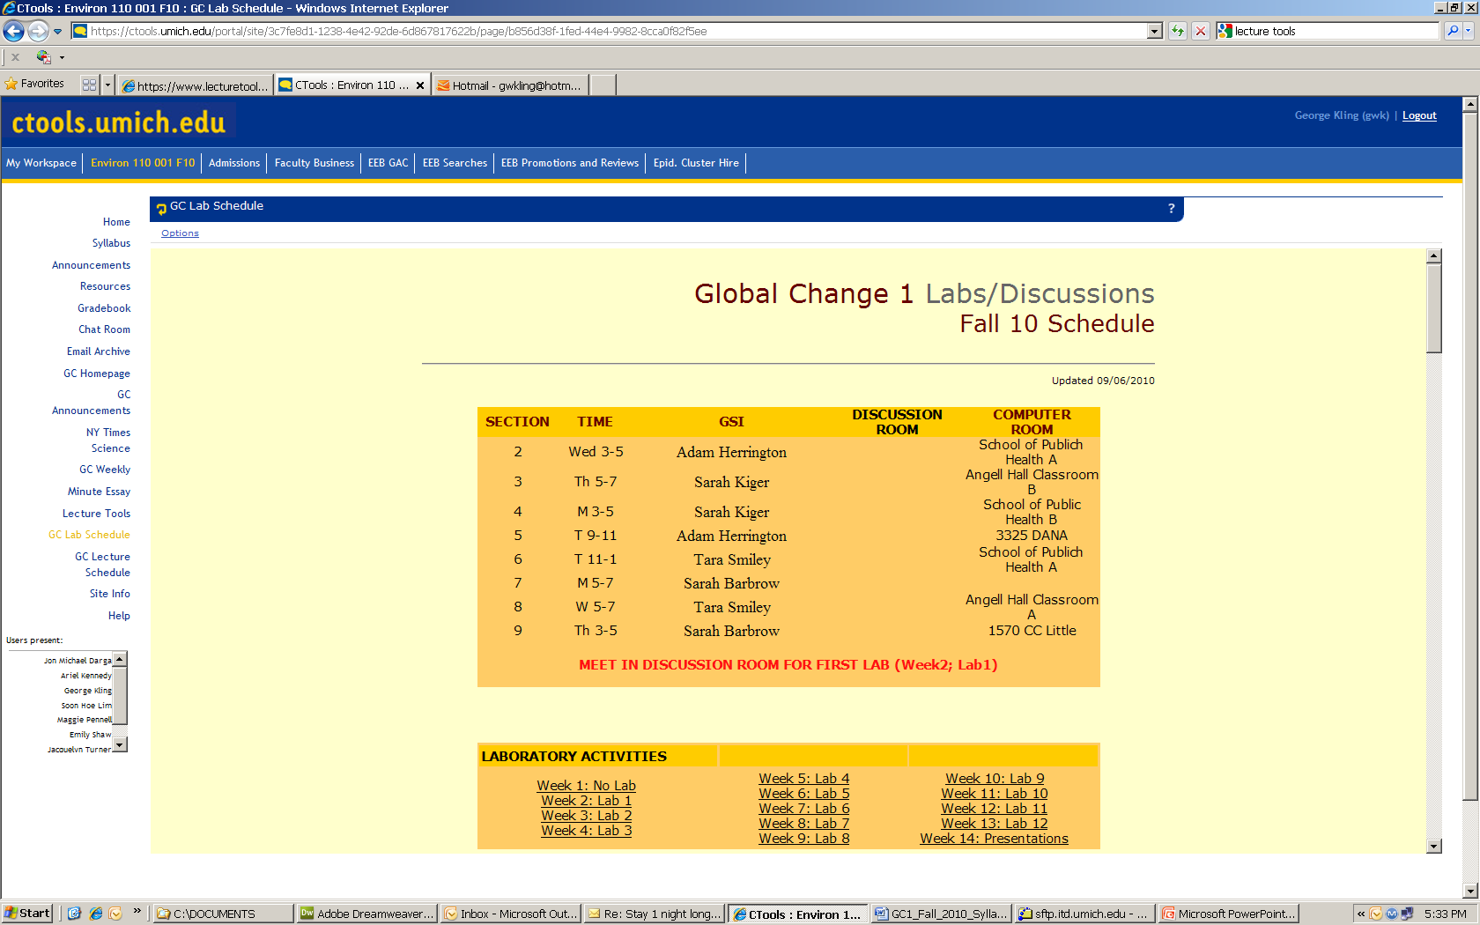
Labs: Discussions and Analysis
Before lab, read articles
In class, discuss questions and activities related to the articles to explore our role in global change.

Slide 10
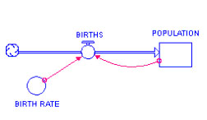
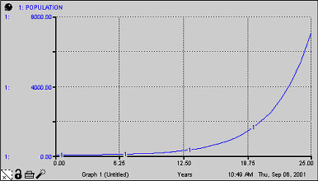
System Dynamics Modeling (Stella)
Population Example:
BIRTHS = (BIRTH RATE)*(POPULATION)
Stocks are variables of interest
Flows change stocks. Flows go into or out of stocks
Converters change relationships between stocks and flows
Connectors allow information to be passed between variables
Notes:
Modeling is a “way of thinking” which embraces and in fact demands clarity and logic. Regardless of the kind of model being used, developing these skills in rational thought are essential if you want to understand and contribute to the world around you.

Slide 11
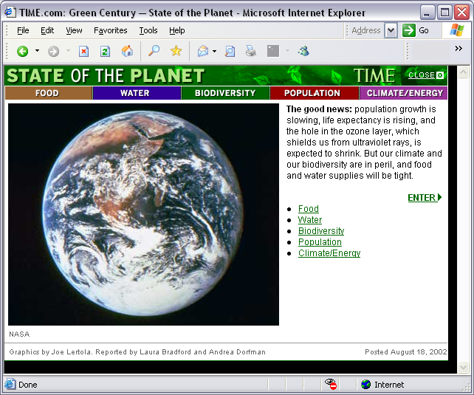
Next Week’s Lab Reading
Before coming to lab, read:
The Challenges We Face –
A History of our Future
2003 State of the World p. 3-13
In Ctools, click on Lab Schedule, then Week 2, then the link for the first lab.
“We have only one or perhaps two
generations in which to reinvent ourselves.”

Slide 12
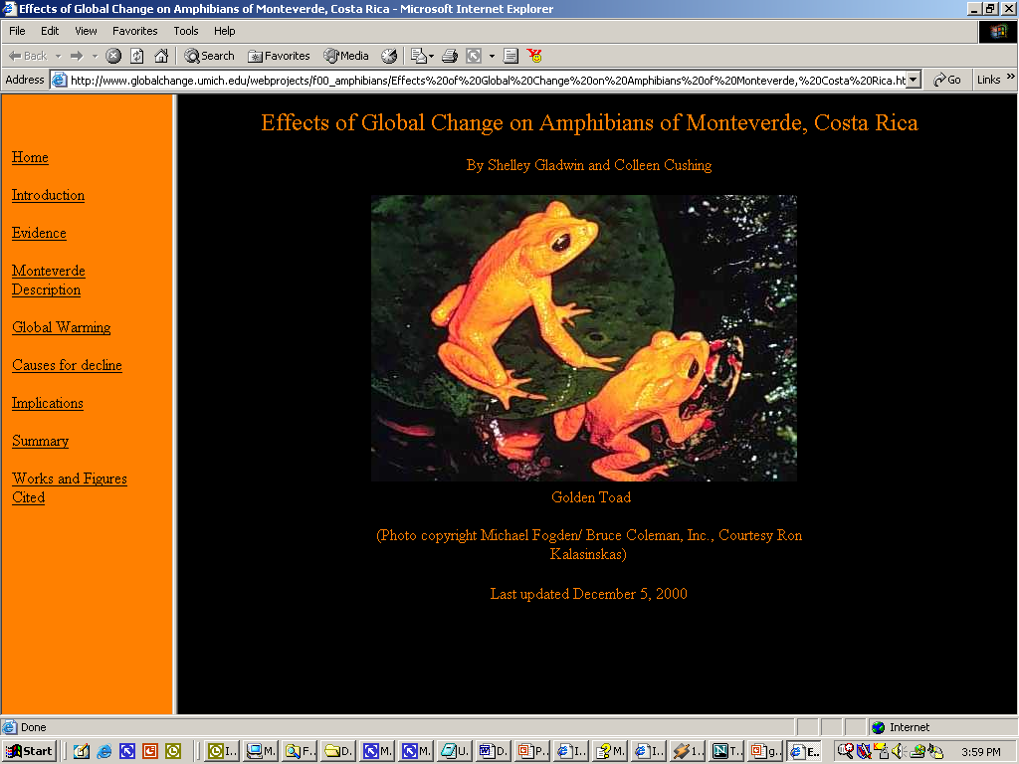
Group Term Project
The term project is a group research activity that will be presented in a PowerPoint class presentation and posted as a website.
Students organize into teams of 3 to develop a plan and implement the project related to the course material.
Suggestions for project topics and sample projects are offered, but the choice will be left to each team with guidance from your lab instructor.
Notes:
Mention the “tyranny of classrooms” in that you learn what the prof wants you to learn, not what you want to learn. So we have projects to compensate for that, and they are actually a large part of your lab grade.

Slide 13
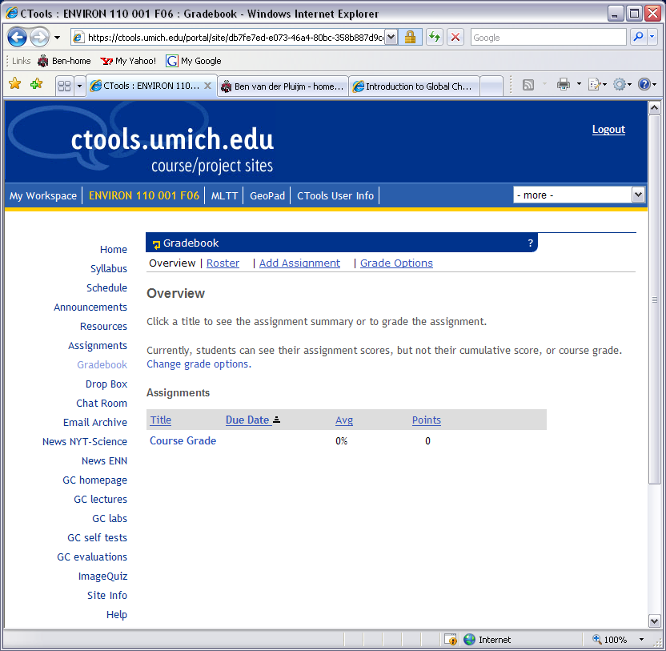
Syllabus – Grades et al.
The class uses a point system
for determining final grades:
  2 in-class midterms: 100 points each
  1 Final exam: 150 points
  Lab/Discussion: 13 points
  each (hand-in by next lab)
  Lecture Homework: 5 points
  each (hand-in by next lab)
  Term Project: 100 points total
  Surveys/Assessments: 1 point
  each (excluding UM's E&E)
Optional, non-graded self-tests for lectures available as a link on the CTools site.
The total points are normalized on a scale from 0-100, using a straight scale for letter grades. The grades are posted on the syllabus (roughly as follows):
  0-59 = E
  60-62, 63-65, 66-69 = D-, D, D+
  70-72, 73-75, 76-79 = C-, C, C+
  80-82, 83-85, 86-89 = B-, B, B+
  90-92, 93-95, 96 and up = A-, A, A+
Notes:
Now some nuts and bolts.
The syllabus is posted, as are the exam dates including the final exam. If you already have a conflict and a plane ticket that keeps you from attending the exams, come up after class and let me know so that we can work something out.

Slide 14
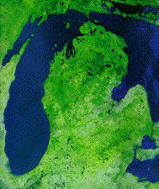
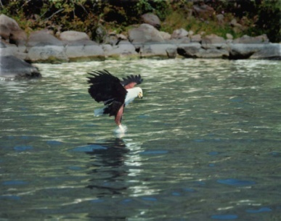
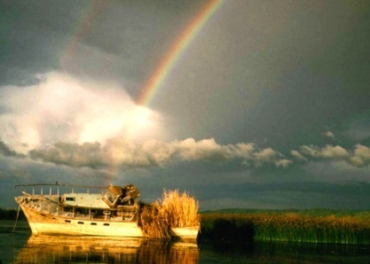
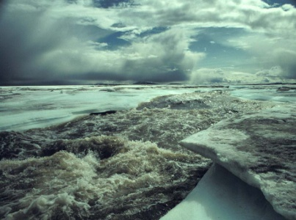
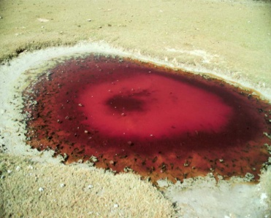
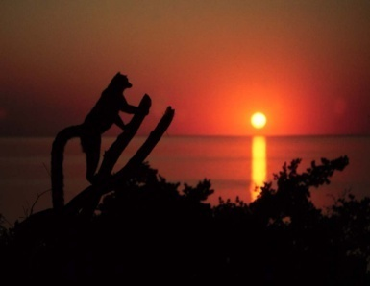
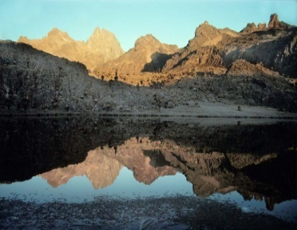
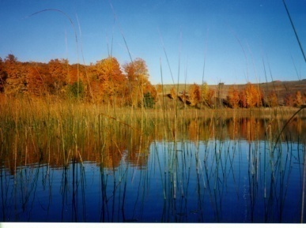
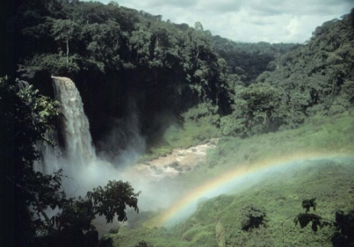
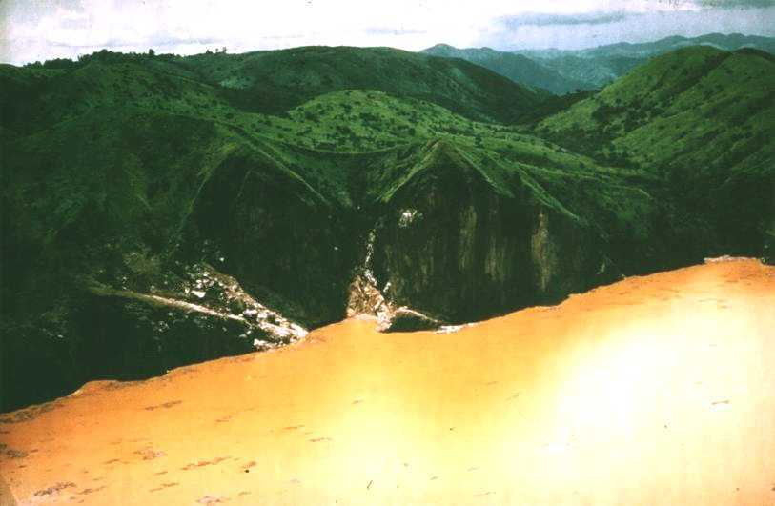
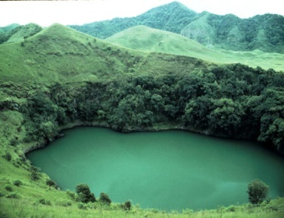
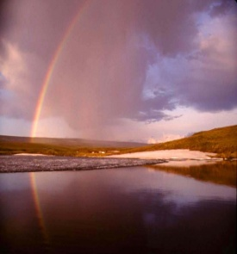
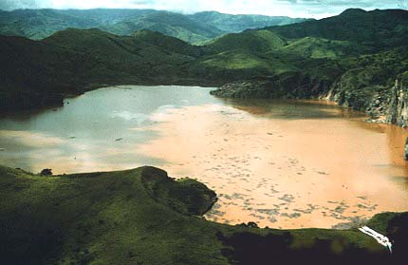
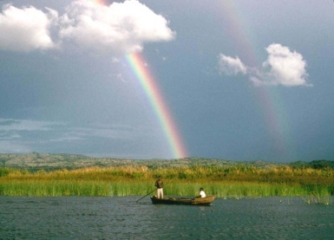
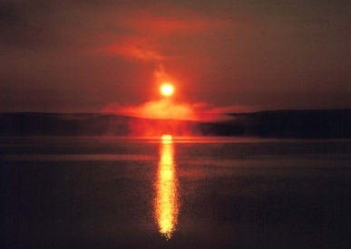
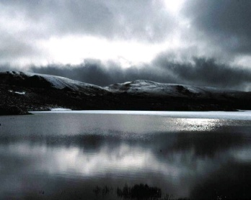
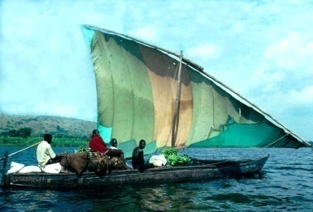
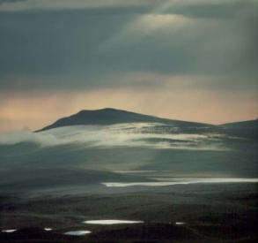
George Kling
Department of Ecology &
Evolutionary Biology
1041 Natural Sciences Bldg
gwk@umich.edu
Teaching:
Global Change (Bio 110)
Ecosystem Ecology (EEB 476)
Limnology (study of lakes; EEB 483)
Research:
Aquatic Ecosystems
Impacts of Climate Change
Biogeochemistry
Arctic, Africa, Michigan
Notes:
Best to get a hold of me by email.

Slide 15
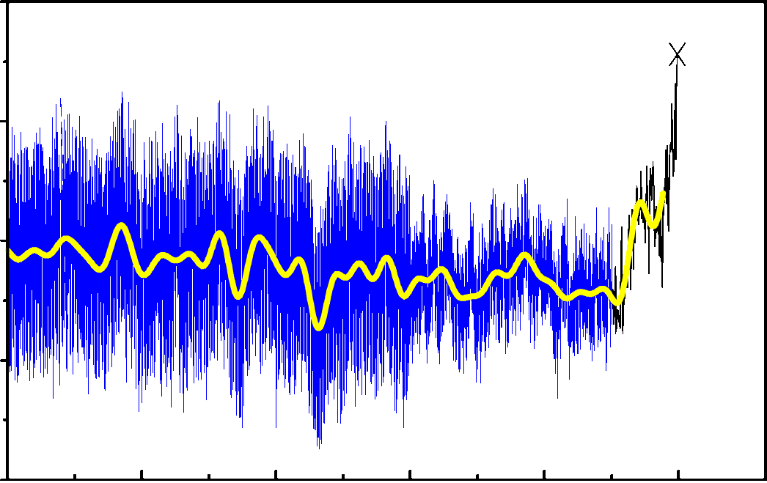
“Recent” climate change and variability…
2
1
N.H. Temperature (°C)
0
-1
1000
1200
1400
1600
1800
2000
Year
Mann et al. (1999) GRL 26:759-762
Notes:
* This shows the past record of temperature in the northern hemisphere for the last 1000 years.
* The first thing to notice is that the temperature has been fairly constant over that time, and the second thing to notice is that there is “variability” in the record – there are cold years and warm years.
* The third thing to notice is that starting about when all of you were born, the average temperature of the Earth started to increase.
* And you can see now that the current temperate is higher than any of the natural fluctuations (science word is variance) of the past.
* This past record in climate change provides perspective on where we are headed… (next slide)

Slide 16
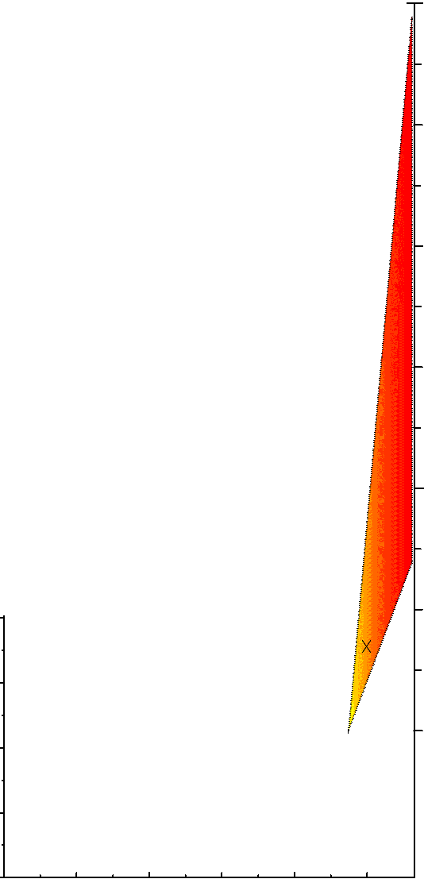
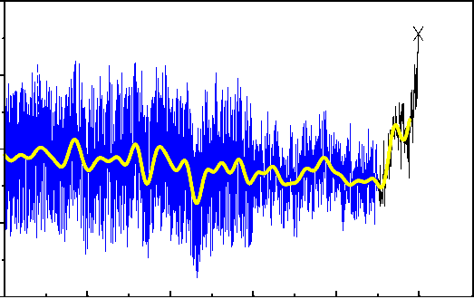
6
…provides perspective on where we are headed
5
Global Temperature (°C)
4
3
This is your future…
2
1
1
0.5
N.H. Temperature (°C)
0
0
-0.5
IPCC Projections
to 2100
1000
1200
1400
1600
1800
2000
Notes:
* This is where we are headed, no question about it. Same slide as before, but now with the range of predictions of future temperature increases by the end of this century.
* We have a blueprint for what to do about it, that is, reducing our greenhouse gas emissions, but it is much more complex than that.
* What we will learn in this class is something about that complexity, including how we know about this past variation, and how we can make such predictions into the future.

Slide 17
My Themes
Global change on our planet can only be understood by combining “abiotic” and “biotic” components – must look at the whole Ecosystem
A combination of facts and scientific concepts can help us understand even the most complicated problems
Science is NOT hard, and everyone can and MUST learn enough to make rational decisions about our world’s future
Notes:
Overall these are my themes --

Slide 18
Possible Projects
The “missing sink” - Where did all the CO₂ go?
Microbes rule, Humans drool
Does the rainforest really matter?
The day the Earth turned brown and blue – The limits to food production
Who’s doing who? Climate skeptics and the use and misuse of Science facts
Who needs more ice? Melting the Earth’s glaciers (a.k.a. “Water World 2050”, starring C. Poulsen as K. Costner…)
WWF Climate 2012 “rage in the cage” – People vs. Nature
Abrupt climate change – can El Nino’s run wild?
Whatcha gonna do when the rain don’t come – Shifts in the Global water cycle
Notes:
Ask if this roadmap has helped people to understand where the class is headed and what to expect. Ask who thinks it hasn’t helped, or is still “complicated”. There will be some, and that is to be expected because there are 3 professors and the downside is that each one has a different style. But the upside is that you will never get this experience again with 3 profs in one class, and in fact this is probably the best way of doing it because you sort of get the “best of” album from each of them. Face it, most profs don’t have enough insight about the world to last a full semester – I’ve given you all my secrets just today, in one class! Sure there is more depth in all of it, but, the general tools that I use in my professional life you now know. It is relatively simple, really, and yet it has kept me in beer and chips for quite a while…

Slide 20
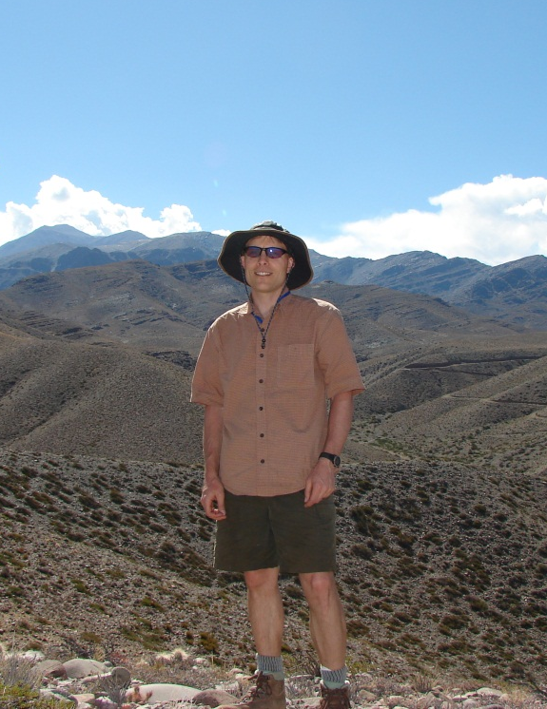
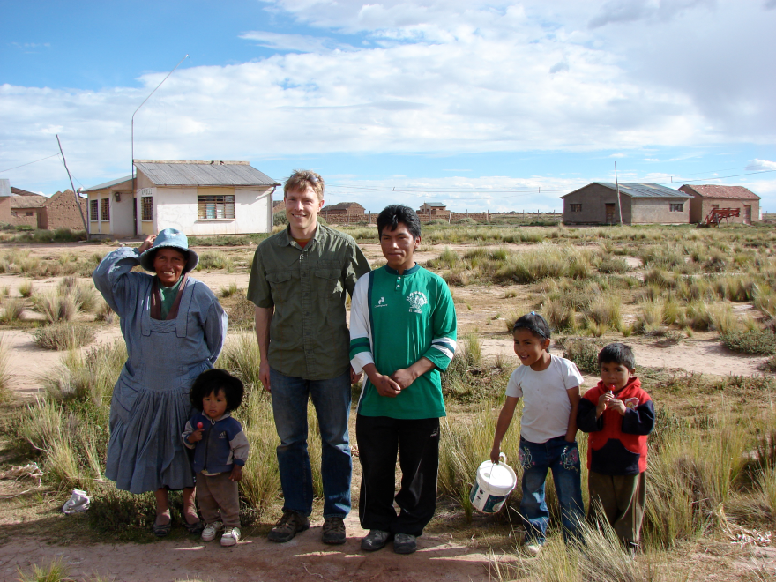
Chris Poulsen
Associate Professor in Dept. of Earth and Environmental Sciences
Research Themes
Paleoclimate (ice ages, extreme warmth)
Climate impacts
Climate and tectonics
Water and climate
Classes
GS114 – Global Warming
GS116 – Intro Geology in the Rockies
GS202 – Intro Environ Science in the Rockies
GS331 – Climate & Climate Change
AOSS410 – Earth System Modeling

Slide 21
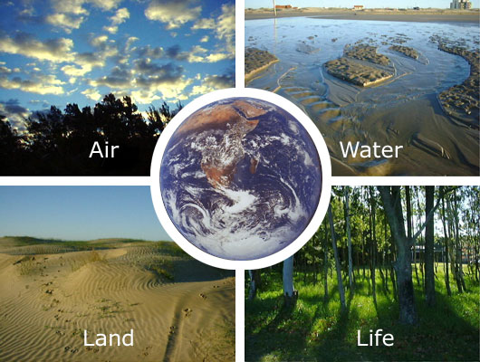
Research – Earth System Physics
How does it work??

Slide 22
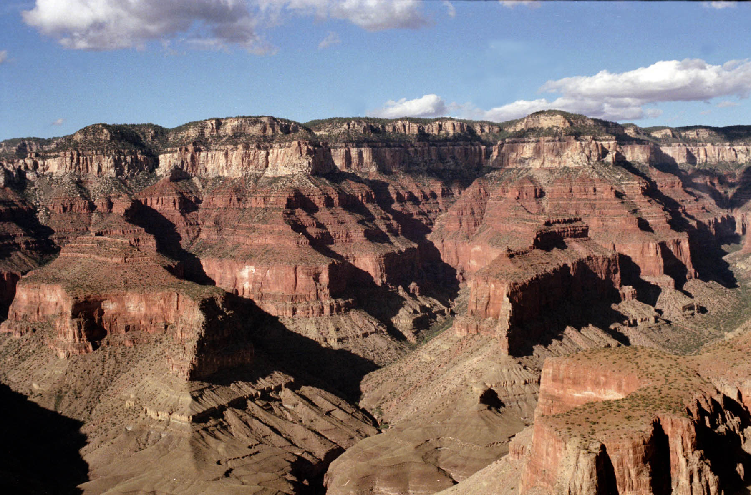
Overview: Earth history and physics
The Earth has a rich and varied history. What does this history tell us about how the Earth operates and how it might change in the future? What is our place in this history?

Slide 23
Our Place in Space
How did ‘IT’ all start?
What are the origins of our solar system and planet Earth?
How do we know?
EARTH

Slide 24
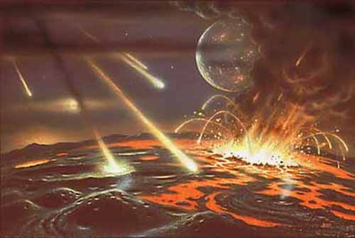
Evolution of a Habitable Earth
Why is Earth the only habitable planet in our solar system?
What were the steps in making a habitable Earth?

Slide 25
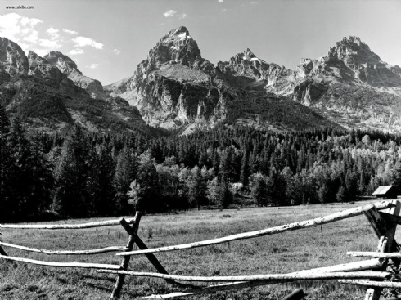
Our Solid Earth: Plate Tectonics
What is the age of the Earth, and how do we know?
What controls the major features on Earth’s surface?
Present
150
280

Slide 26
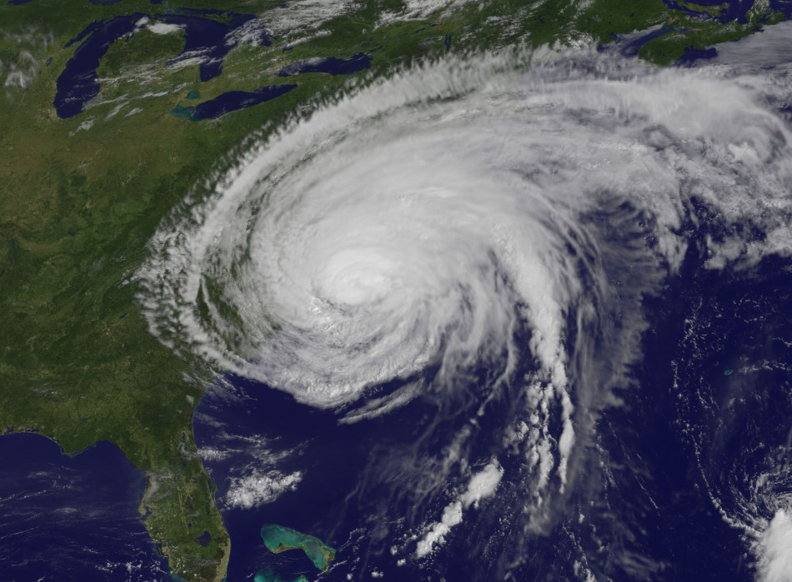
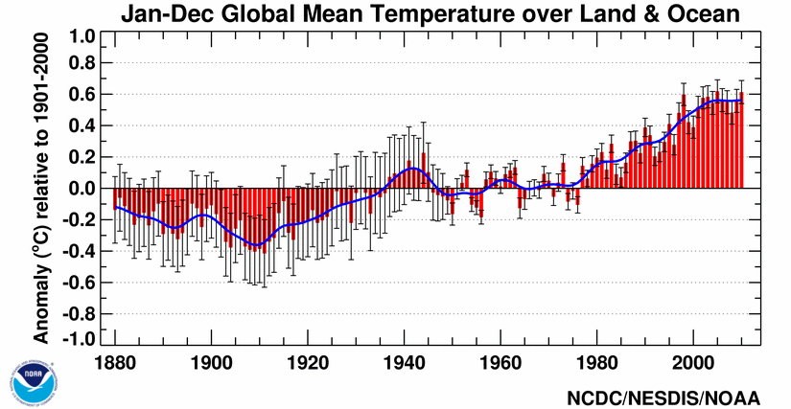
Our Fluid Earth: Atmosphere & Ocean
From fiery hell to deep freeze. What controls Earth’s climate?
Why do the winds blow?
Global warming? How, why, and so what?

Slide 28
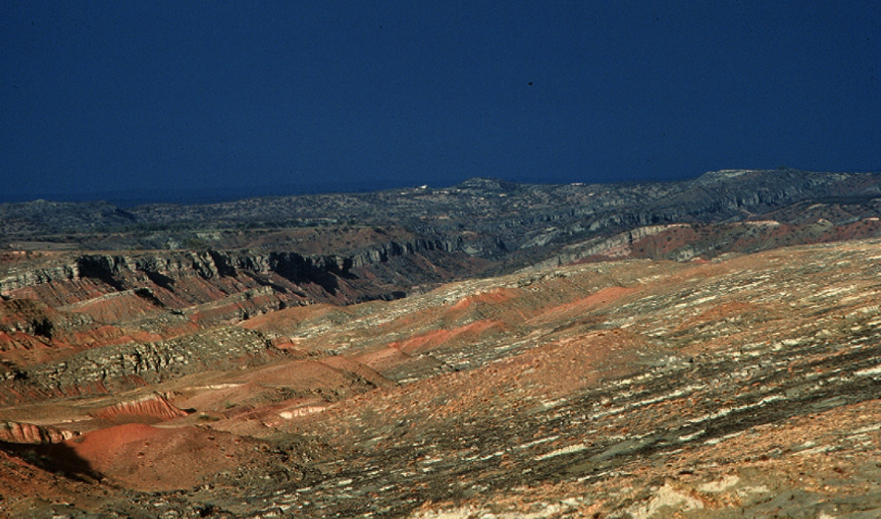
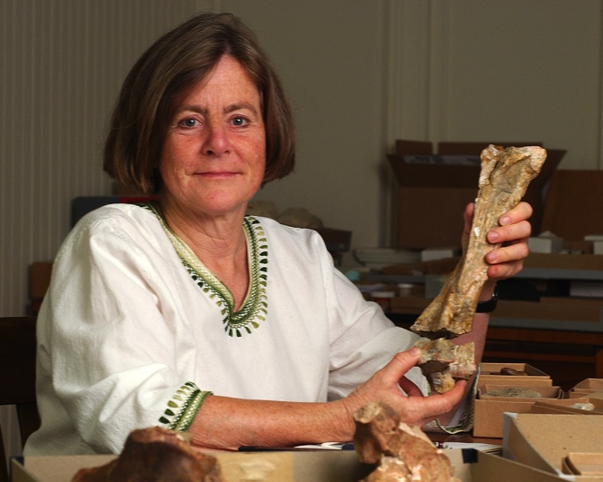
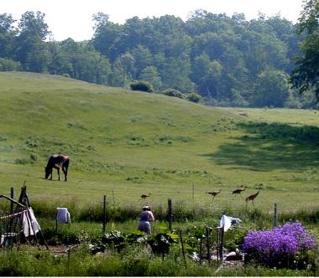
Catherine Badgley
Research interests
Fossil record of mammals
How mammals respond to climate over deep time
How landscapes influence mammal diversity
How agriculture affects biodiversity
Teaching
Global Change I
Food, Land, and Society
Biogeography
Notes:
Upper right photo is my major fossil site in Pakistan.
Lower right is me working in my garden.

Slide 29
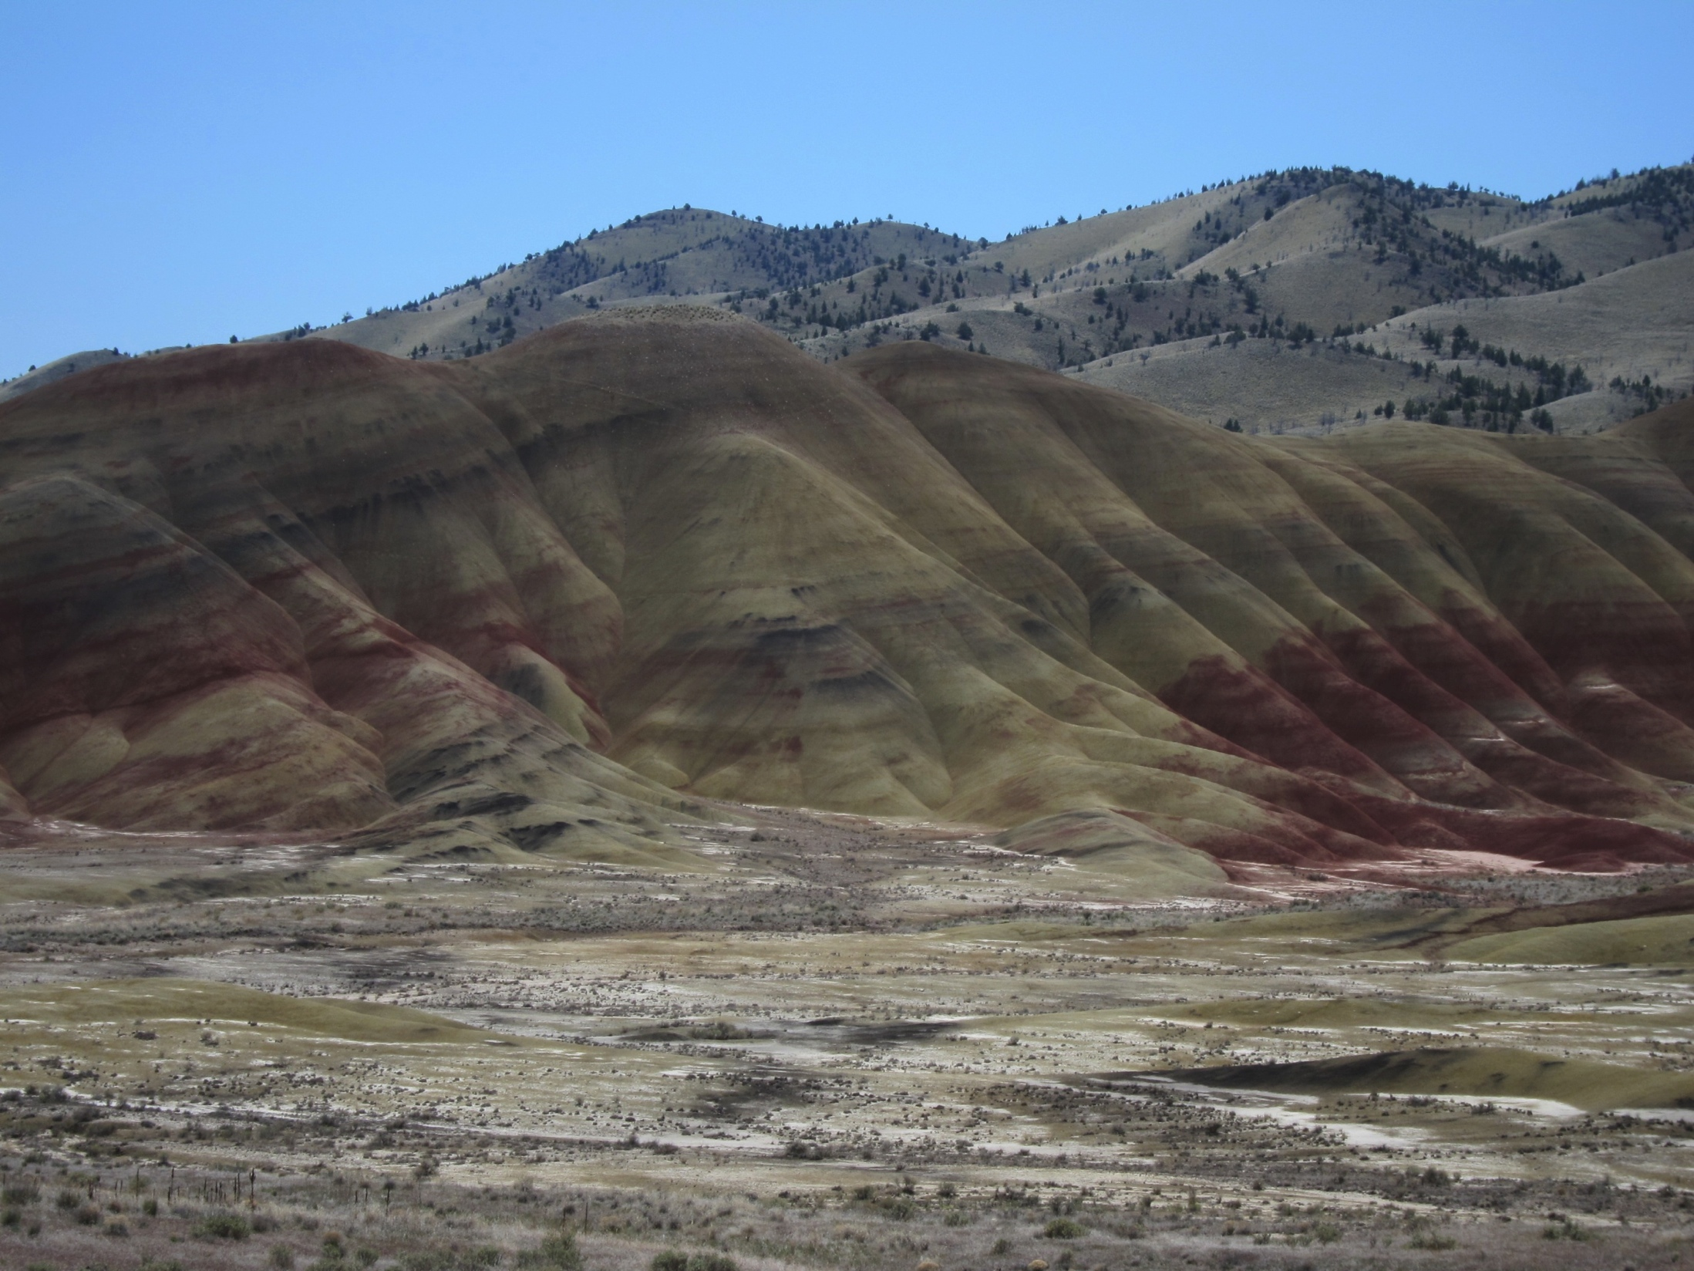
Oregon: Painted Hills

Slide 30
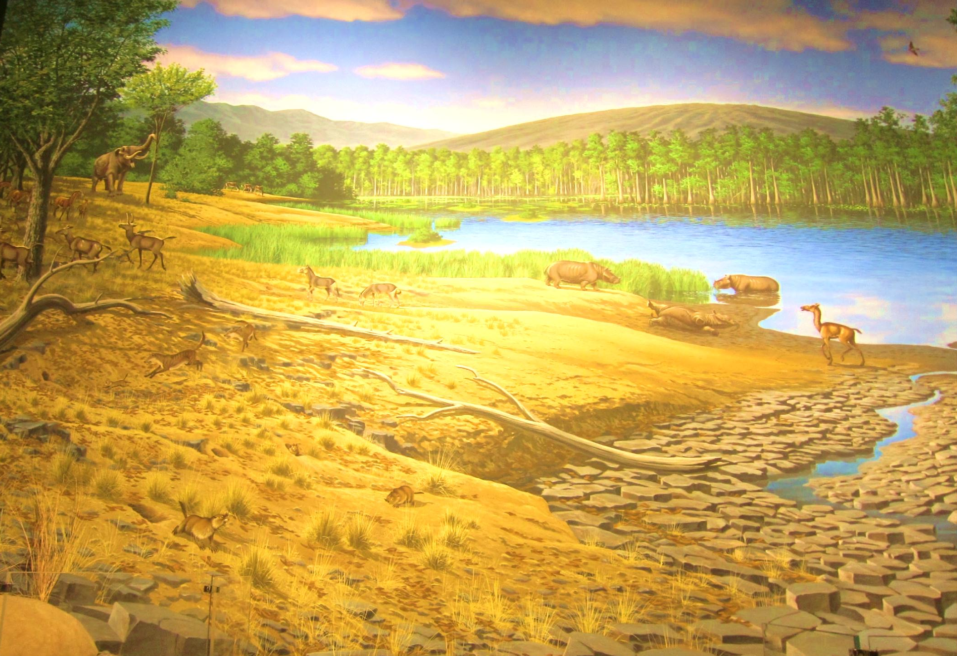
Oregon 18 million years ago

Slide 31
My themes in Global Change I
What processes are responsible for the diversity of life?
Evolution, adaptation, species formation.
In what ways does the physical world influence living systems?
Earth history determines the environmental context of diversification and extinction.
How do organisms interact within ecological communities?
Through competition, predation, mutualism.
How have human activities affected ecological communities
and what is at stake?
Habitat transformation, endangered species and communities, impaired ecological services.

Slide 32
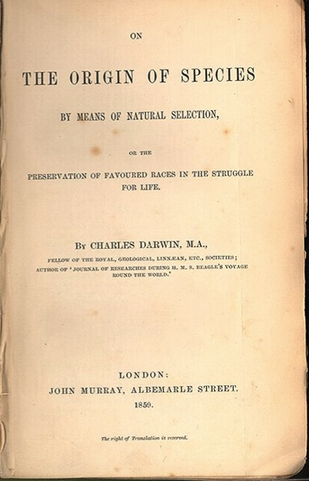
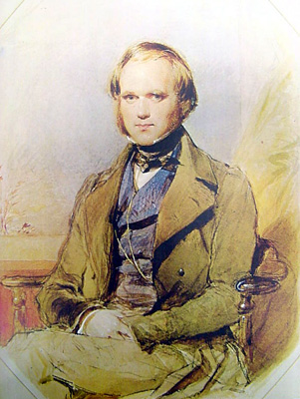
Evolution
Three major ideas
Variation + differential survival and reproduction lead to changes in traits.
Changes in traits + geographic separation lead to formation of new species.
All species are related by descent from common ancestor.

Slide 33



Ecology
Biological diversity depends on physical world for energy and habitats.
Species interactions are the basis for collaboration and competition for life’s essential resources.

Slide 34


Relationships and Interdependence
Menzel and D’Alusio, Hungry Planet
http://tolweb.org/tree/phylogeny.html
Notes:
All of these interactions impact our well being.

Slide 36

Global Change Curriculum and Minor
http://www.globalchange.umich.edu/
36

Slide 37

37

Slide 38
The GC2 Wheel of Lectures (Winter Semester)
Sustainability
Transdisciplinarity
Systems Thinking
GLOBAL CHANGE
Roadmaps
(DA)1/5, 1/8
(RH)1/10
(TG)1/12
Systems and
Sustainability
(TG) 1/17
and 1/19
Adaptation
to Appropria-tion
of Nature
(DA) 1/22-26 ;
(RH) 1/26-1/31
(
Colonialism to modern
Resource Depletion
(DA) 2/9-2/14
(RH) 2/16-2/23
Climate
Change:
Mechanisms
And Impacts
(VDP) 3/12,
3/14, 3/16
Biodiversity
Conservation
(DA)3/21 and 3/23
(RH) 3/26
Global
Connectivity
And Density
(TG) 3/28, 3/30
Global
Health
(DA) 4/2
(RH) 4/4
Velocity,
Scarcity
Inequality,
Extremity
(TG) 4/6-4-16
How to read this slide: Clockwise from the “midnight” position:
1) First three basic Conceptual & Chronological Units preparing us to think about broad issues of past, present and future
2) The heart of the course is four theme-driven modules on relatively recent past and present issues: colonialism, energy, climate, and conservation
3) We conclude with a future-oriented series of lectures on global trends, including health
Energy past,
Present,
and policy
(VDP)3/5,
3/7.3/9
DA=David Allan
TG=Tom Gladwin
RH=Rebecca Hardin
VDP=Ben van der Pluijm
Notes:
38
Faculty, not wheel spins

Slide 39
Wrapping up
Global Change encompasses all the ways that our planet has been changing since its formation ~4.5 billion years ago to today, and looking toward the future.
Humans are affecting Earth and its life support systems at an unprecedented rate, which poses new challenges to humankind and our planet.
Decisions and good policy require good science.
…. that is why you are in Global Change !
Notes:
Ask if this roadmap has helped people to understand where the class is headed and what to expect. Ask who thinks it hasn’t helped, or is still “complicated”. There will be some, and that is to be expected because there are 3 professors and the downside is that each one has a different style. But the upside is that you will never get this experience again with 3 profs in one class, and in fact this is probably the best way of doing it because you sort of get the “best of” album from each of them. Face it, most profs don’t have enough insight about the world to last a full semester – I’ve given you all my secrets just today, in one class! Sure there is more depth in all of it, but, the general tools that I use in my professional life you now know. It is relatively simple, really, and yet it has kept me in beer and chips for quite a while…

Slide 40
GSI Introductions
Section | TIME | GSI | Open seats
2 | Wed 3-5 | Louise Jeffery | 13
3 | Thu 1-3 | Jeff Shi | 6
4 | Mon 3-5 | Louise Jeffery | 14
5 | Tue 9-11 | David Rosier | 11
6 | Tue 11-1 | Meghan Taylor | 4
7 | Mon 1-3 | Jeff Shi | 1
8 | Wed 1-3 | David Rosier | 7
9 | Thu 3-5 | Cancelled | --
MEET IN DISCUSSION ROOM FOR FIRST LAB (Week 2; Lab 1)

