Slide 1
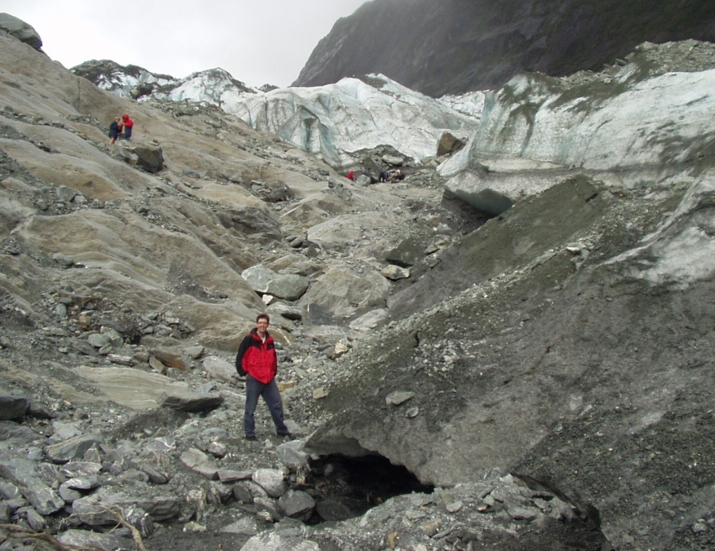
Ben van der Pluijm
Bruce R. Clark Professor of Geology
Professor of the Environment
Director Global Change Program
www.globalchange.umich.edu/Ben
vdpluijm@umich.edu or globalchange@umich.edu
Research: Structural Geology
field areas: the northern Appalachians, the USA continental interior, North and South America’s Grenville, northern Spain’s Cantabria, East African Rift, US-Canadian Rockies, San Andreas (CA) and Alpine (NZ) faults.
topical areas: brittle and ductile faults, deep-crustal architecture, fault gouge and pseudotachylyte, intraplate stresses, oroclines, clay microstructures and textures, magnetic anisotropy, X-ray goniometry, paleomagnetism, geochronology, physical oceanography
Teaching
Interdisciplinary undergraduate teaching (Global Change), Environmental Geology, concentrator and graduate level specialty classes, IT-supported classroom education (GeoPocket), IT-supported field-based education (GeoPad).
Notes:
Franz Josef glacier in NZ

Slide 2
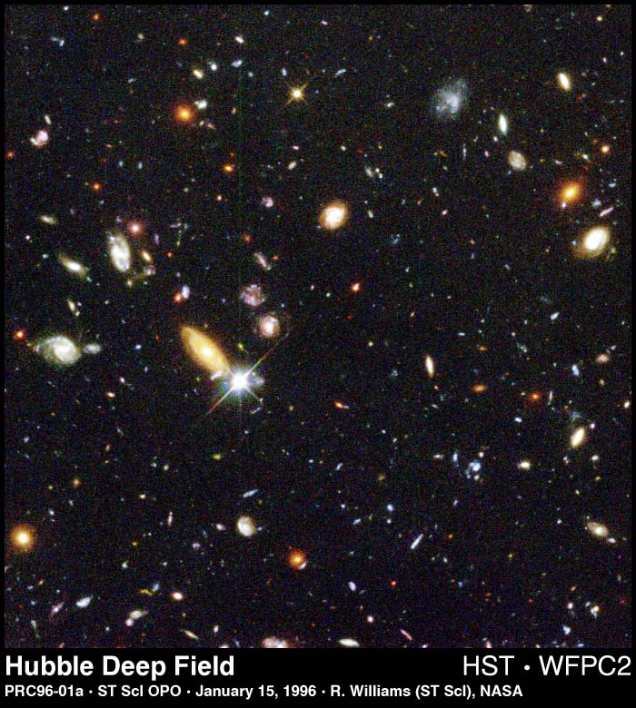
The Universe and Stuff (start of term)
We discuss ....
Evidence and age of the Big Bang
About electromagnetic radiation (“light”)
Fundamentals of energy
Matter (elements)
Solar system and Early History of Earth

Slide 3
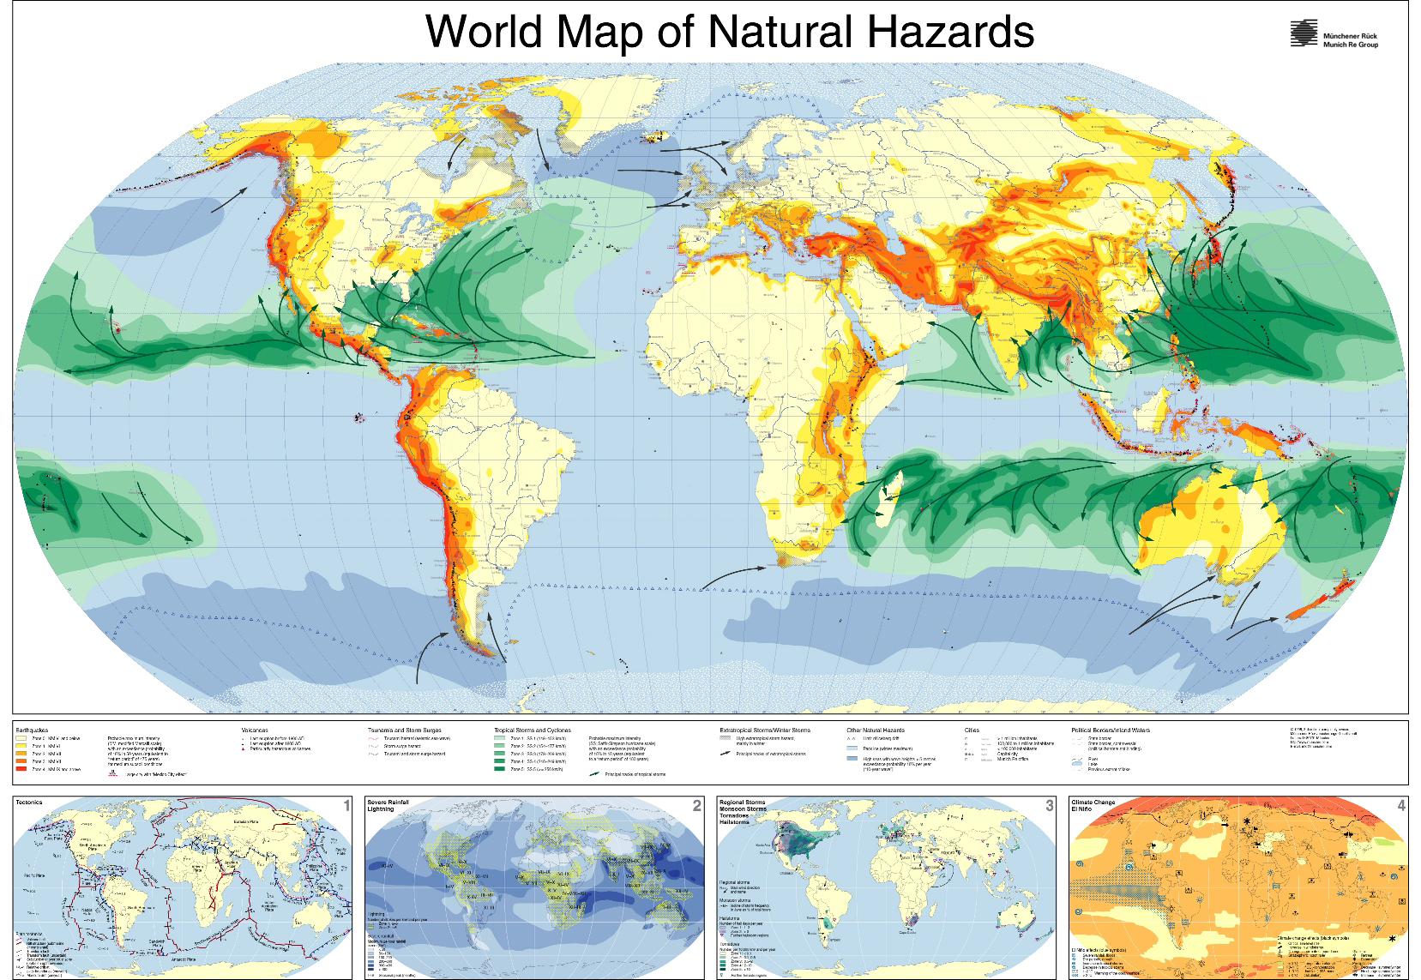
World of Hazards (end of term)
http://www.munichre.com/

Slide 4
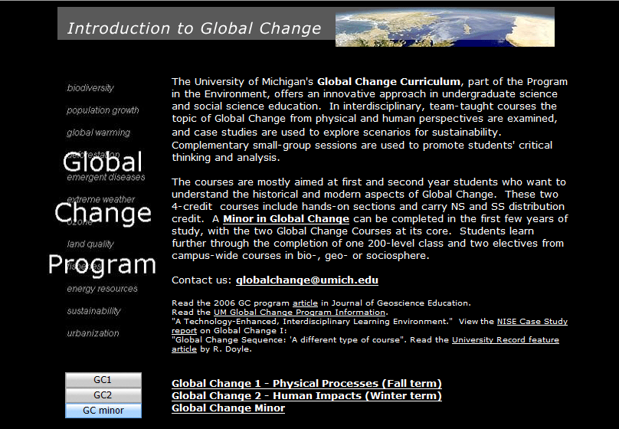
Global Change Curriculum and Minor
http://www.globalchange.umich.edu/

Slide 5
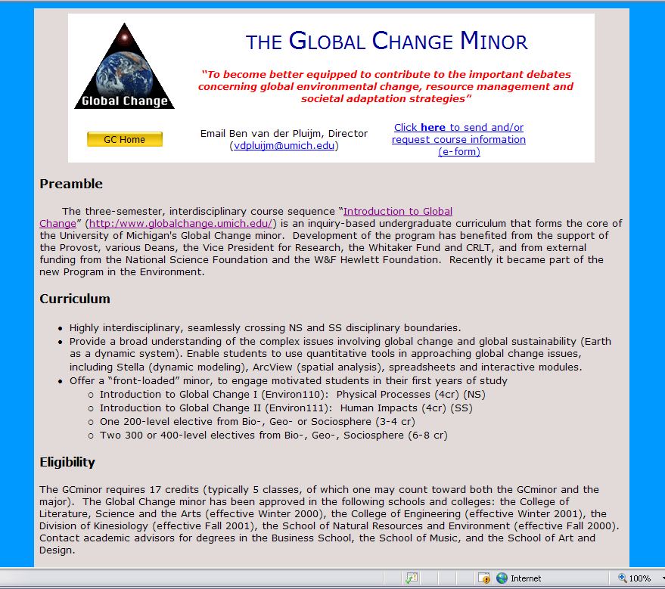

Slide 6
The GC2 Wheel of Lectures (Winter Semester)
Sustainability
Transdiciplinarity
Systems Thinking
GLOBAL CHANGE
Roadmaps
(DA)1/5, 1/8
(RH)1/10
(TG)1/12
Systems and
Sustainability
(TG) 1/17
and 1/19
Adaptation
to Appropria-tion
of Nature
(DA) 1/22-26 ;
(RH) 1/26-1/31
(
Colonialism to modern
Resource Depletion
(DA) 2/9-2/14
(RH) 2/16-2/23
Climate
Change:
Mechanisms
And Impacts
(VDP) 3/12,
3/14, 3/16
Biodiversity
Conservation
(DA)3/21 and 3/23
(RH) 3/26
Global
Connectivity
And Density
(TG) 3/28, 3/30
Global
Health
(DA) 4/2
(RH) 4/4
Velocity,
Scarcity
Inequality,
Extremity
(TG) 4/6-4-16
How to read this slide: Clockwise from the “midnight” position:
1) First three basic Conceptual & Chronological Units preparing us to think about broad issues of past, present and future
2) The heart of the course is four theme-driven modules on relatively recent past and present issues: colonialism, energy, climate, and conservation
3) We conclude with a future-oriented series of lectures on global trends, including health
Energy past,
Present,
and policy
(VDP)3/5,
3/7.3/9
DA=David Allan
TG=Tom Gladwin
RH=Rebecca Hardin
VDP=Ben van der Pluijm
Notes:
Faculty, not wheel spins

Slide 7
Interdisciplinary, Natural and Social Science Curriculum examining Dimensions of Global Change
“To become better equipped to contribute to the important debates concerning global environmental change, resource management and societal adaptation strategies.”

