Slide 1
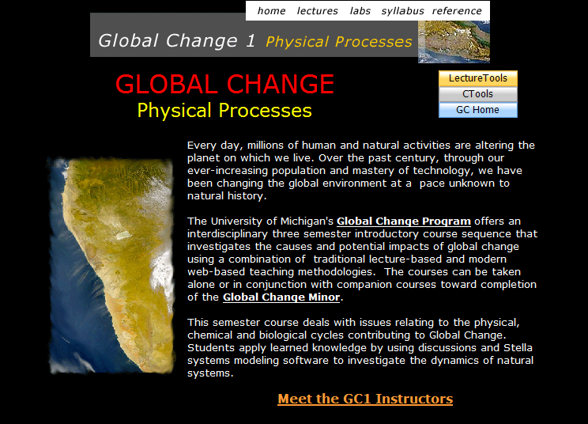
Global Change 1: Physical Processes
Environ 110, Biol 110, Geosci 171, AOSS 171, ENSCEN 171
www.globalchange.umich.edu/globalchange1

Slide 2

Global Change 1: Introductions
Professors
David Allan
School of Natural Resources and Environment; dallan@umich.edu
George Kling
Department of Biology; gwk@umich.edu
Ben van der Pluijm
Department of Geological Sciences, Program in the Environment.
Course Coordinator and Program Director for Academic Minor in Global Change; vdpluijm@umich.edu
GSI team
Sarah Barbrow, Biology
Mathew Densmore, Geology
Peter Esselman, SNRE
Menan Jangu, Anthropology/SNRE
Support
Haley Cureton; globalchange@umich.edu
Email: globalchange@umich.edu

Slide 3


Interdisciplinary, Team-taught
Natural and Social Science Curriculum
“To become better equipped to contribute to the important debates concerning global environmental change, resource management and societal adaptation strategies.”

Slide 4
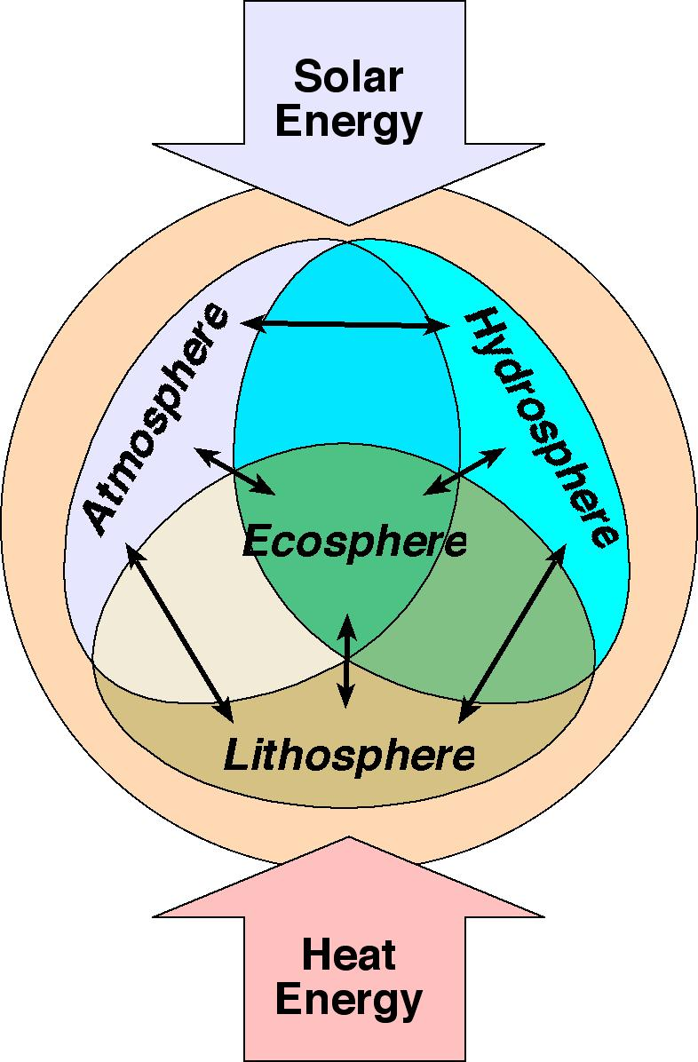
GC1 - Course Objectives
Understand Earth as an integrated system:
Change and evolution (stars, solar systems, atmosphere, soils and life evolve from precursors)
Underlying physical and natural processes and how they are integrated
Variability and uncertainty (climate has always varied, prediction is difficult in complex systems)
Human alteration of Earth's physical and biological systems (rates)

Slide 5
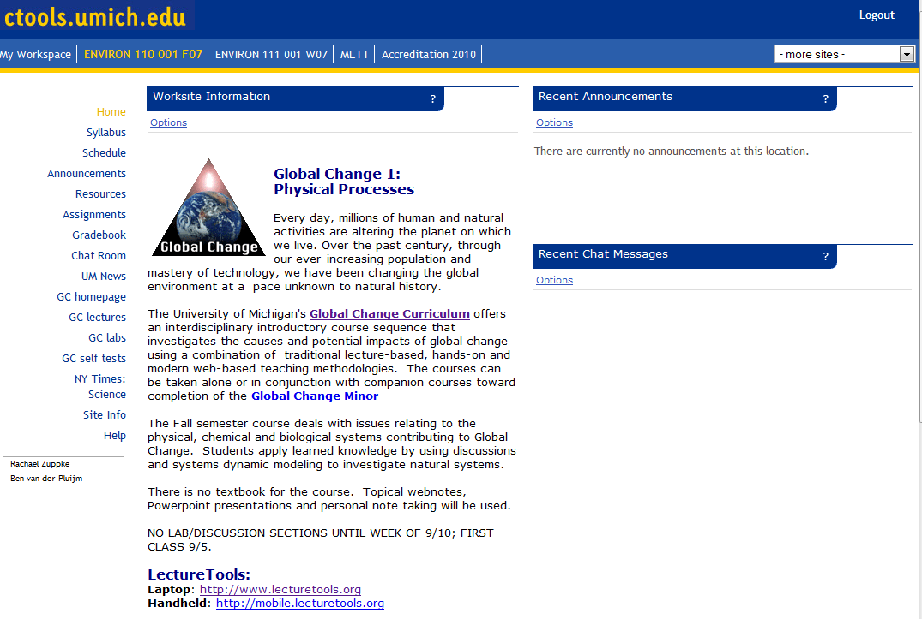
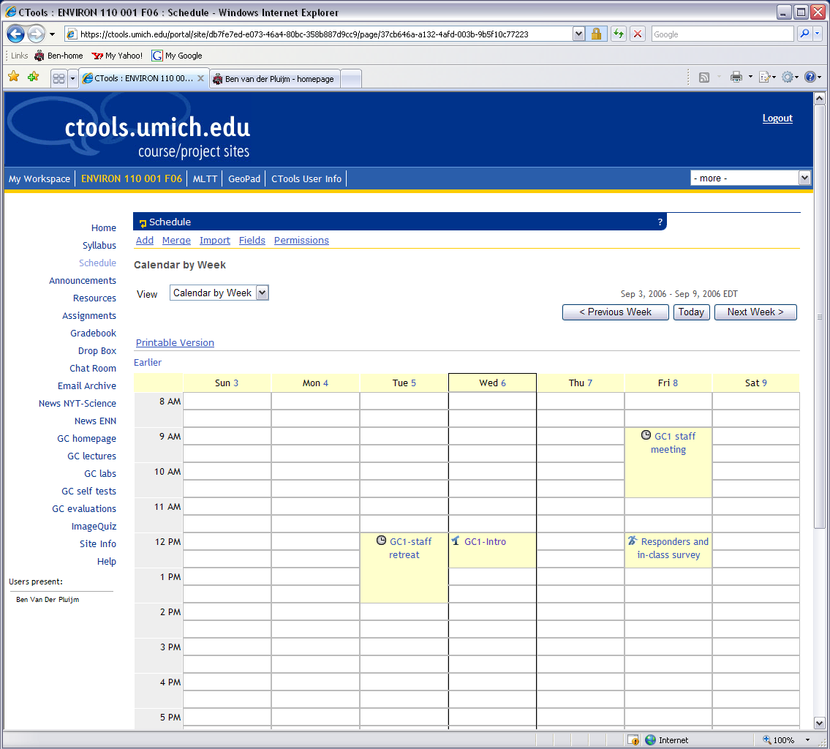
Course Management: U-M’s Ctools
https://ctools.umich.edu/

Slide 6
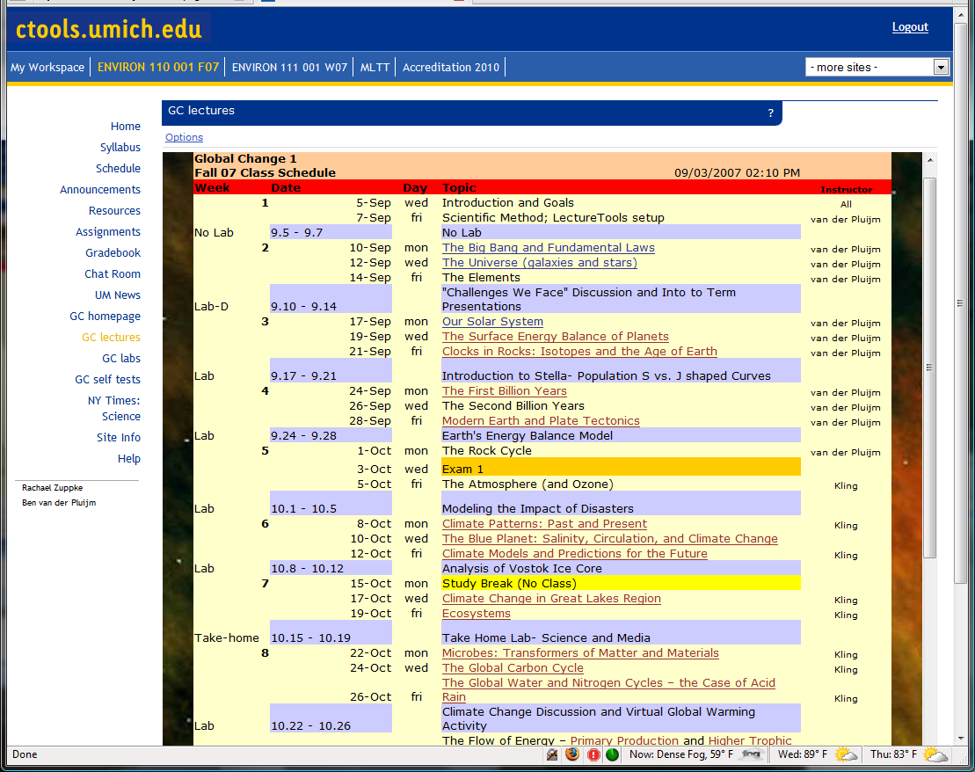
Lectures

Slide 7
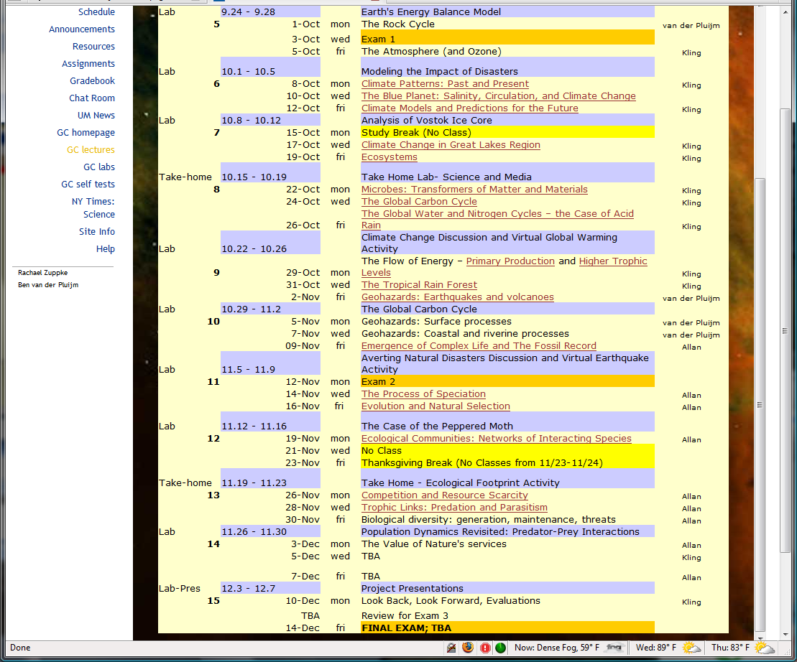
Lectures, ctd.

Slide 8
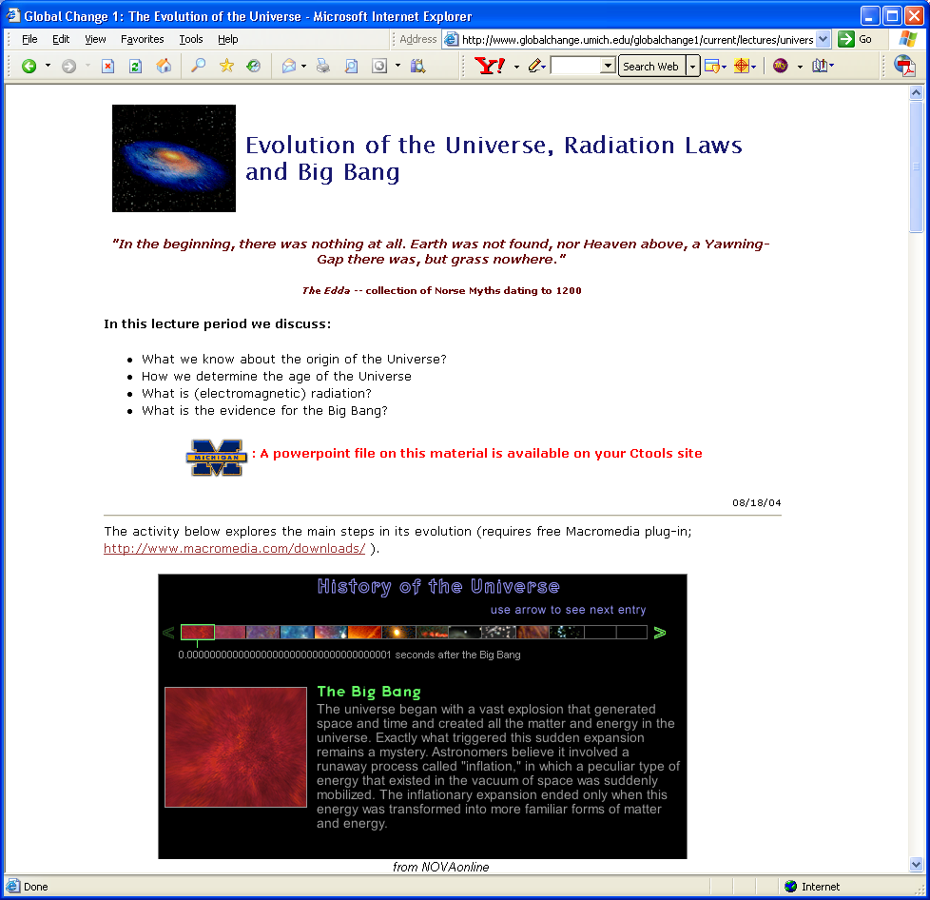
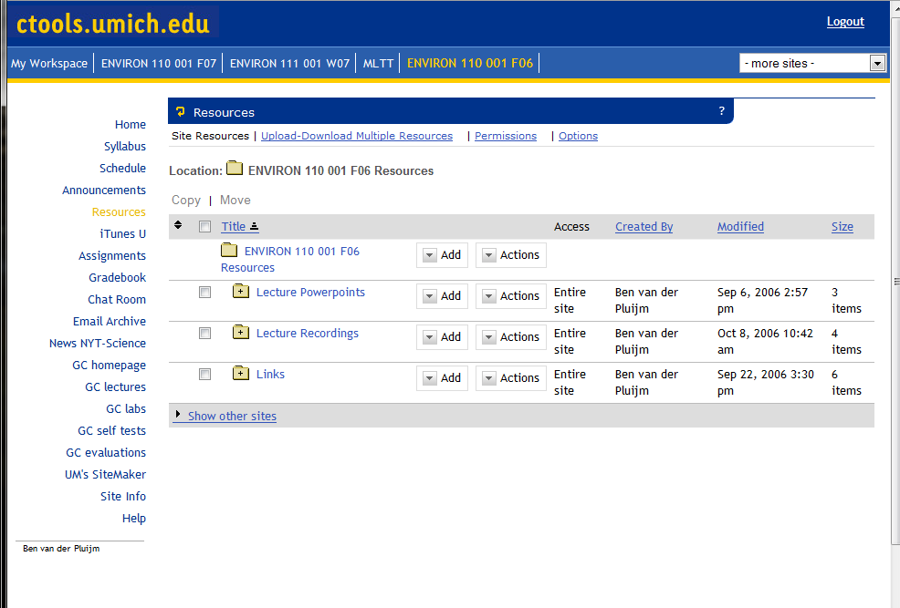
Lecture Notes and PowerPoint files
Supporting notes on-line (but they do not replace lectures)
PowerPoint slides through Ctools and LectureTools (updated prior to lectures)
Your own class notes. Be here, so you learn more and won’t be surprised

Slide 9
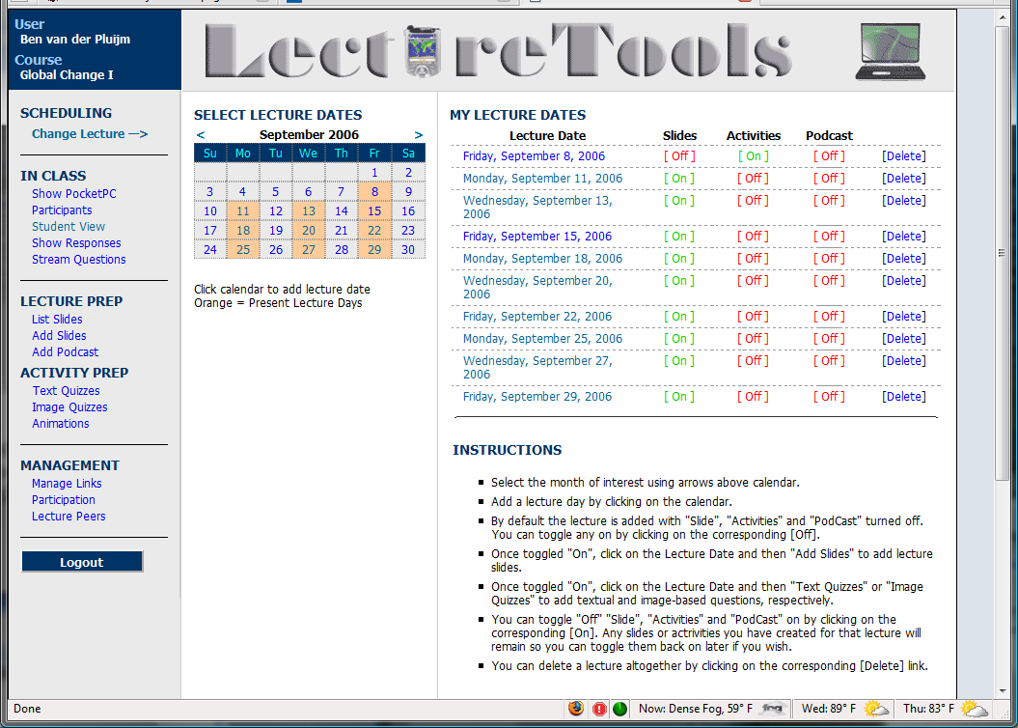
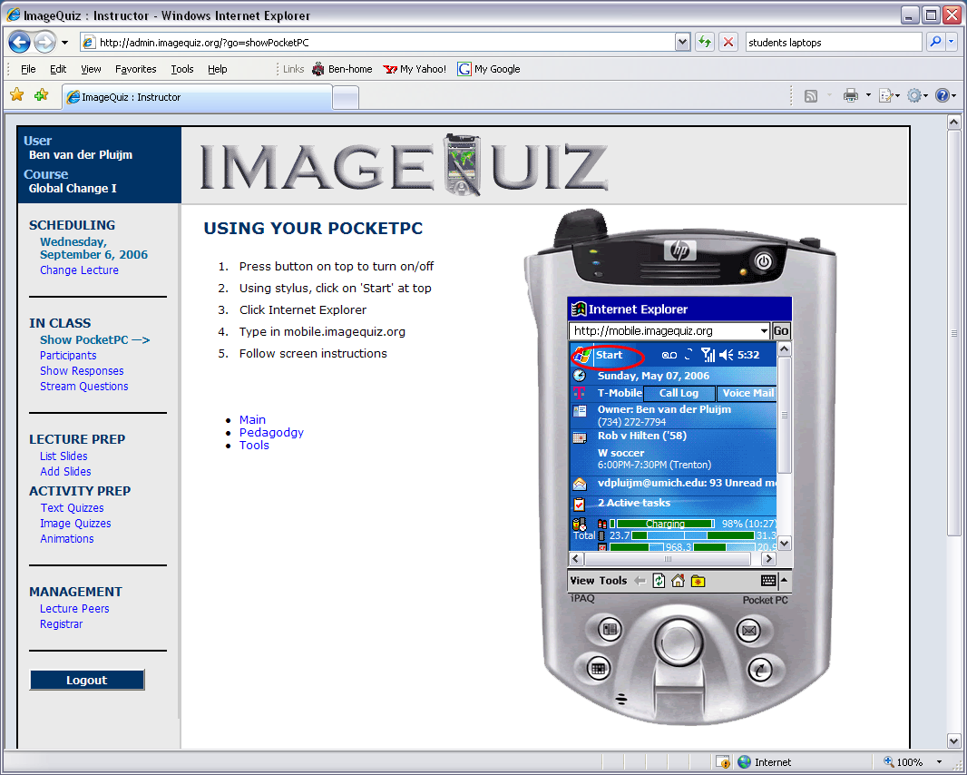
Information Environment (LectureTools)
Bring your wireless-enabled laptop to class for lecture notes, web access and real-time searches
(and IM, Facebook, YouTube, ....)
Details on Friday ….

Slide 10
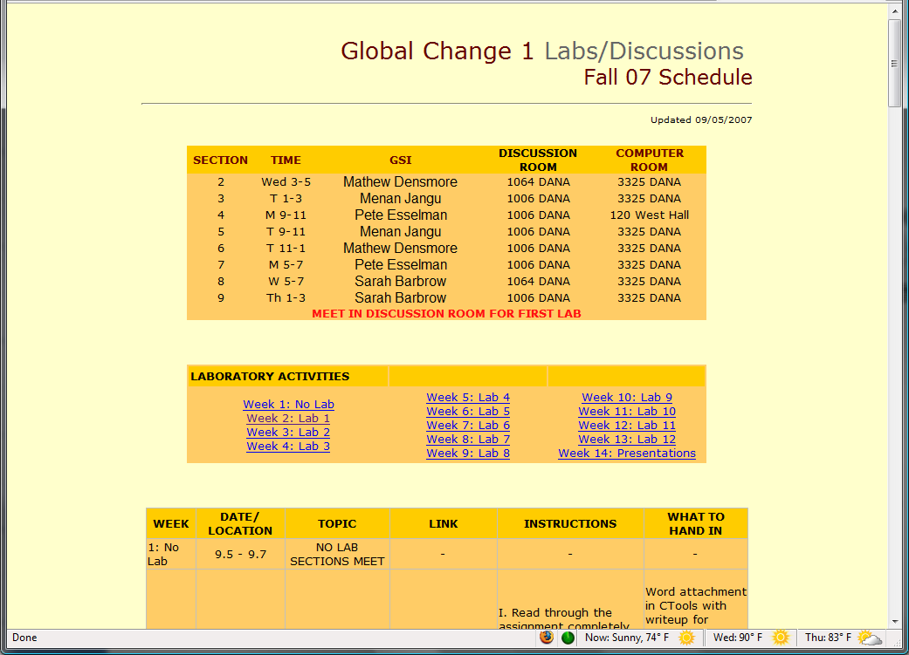
Labs: Discussions and Analysis

Slide 11
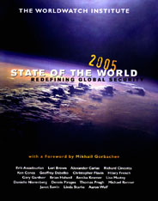
Discussions: Critical Reading & Discourse
Before class, read article(s) from to prepare for (lively) classroom discussions and activities.
In class, discuss questions and complete activities related to the articles to explore our role in global change.

Slide 12
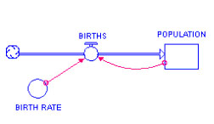
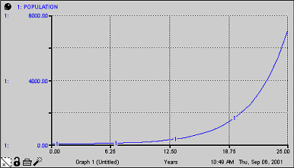
System Dynamics Modeling (Stella)
Population Example:
BIRTHS=BIRTH RATE*POPULATION
Stocks are variables of interest
Flows change stocks. Flows go into or out of stocks
Converters change relationships between stocks and flows
Connectors allow information to be passed between variables

Slide 13
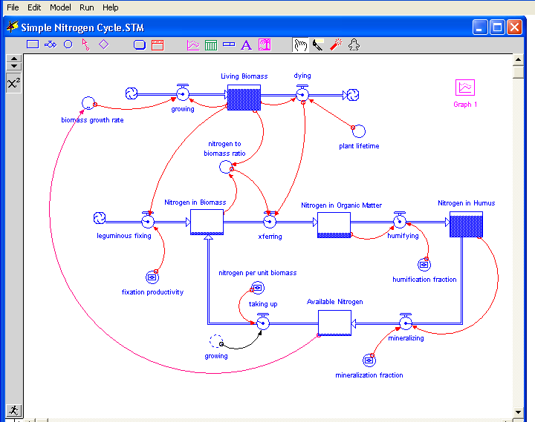
Systems Dynamic Modeling, ctd.
Explore the System
Define the problem and goal of the Model
Build, test and Modify the Model
Explore and analyze the System
Example: the N cycle

Slide 14
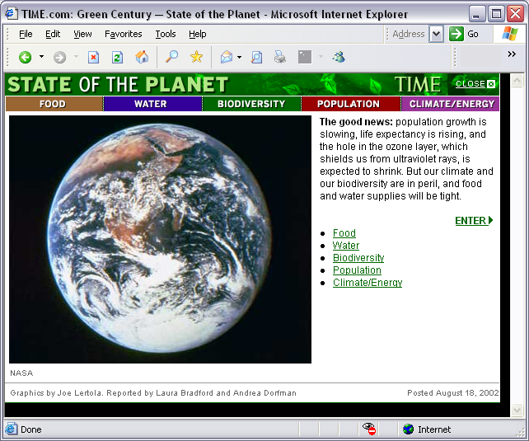
Next Week’s Lab Reading
Before coming to lab, read:
The Challenges We Face –
A History of our Future
2003 State of the World p. 3-13
Questions for Discussion
Question I.c.1
Summarize the five threats presented in the Challenges We Face article. What kinds of steps are being taken to remedy each of these threats? Are we doing enough?
Question I.c.2
Do we face other threats, not addressed in the article? What actions are needed to manage these challenges?
Question I.c.3
What is the difference between a generalist and a specialist species? How might generalist species like us, affect specialists? Should humans be concerned with altering the environment where specialists reside?
Question I.c.4
The article states that, "we have a paralysis of hope." What does this mean? How can we overcome this?

Slide 15
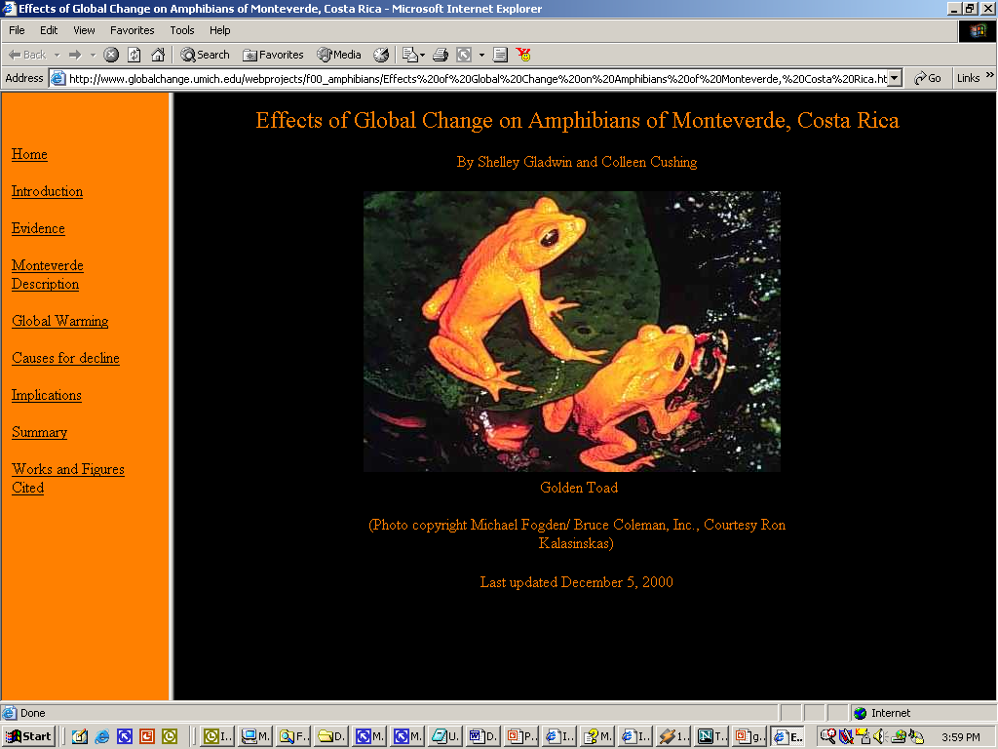
Group Term Project
The term project is a group
research activity that will be
presented in the form of a
(PowerPoint) class presentation
and posted as a website.
Students organize into teams of 3
to develop an implementation
plan for a project related to the
course material.
Suggestions for project topics and sample projects are offered, but the choice will be left to each team with guidance from your lab instructor.
The posted PPT website is due by the team’s presentation in the final lab week.

Slide 16
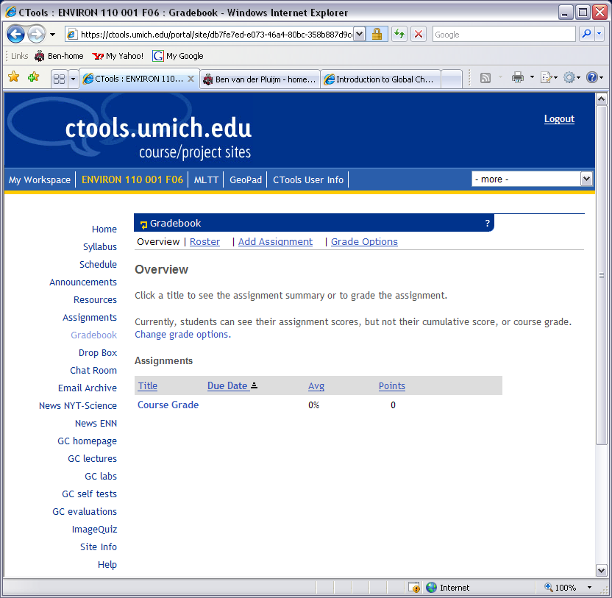
Grades
The class uses a point system
for determining final grades:
  Midterms (2): 100 points each
  Final: 150 points
  Lab/Discussion: 13 points
  each (hand-in by next lab)
  Lecture Homework: 5 points
  each (hand-in by next lab)
  In-class Activities: TBD
  Term Project: 100 points total
  Surveys/Assessments: 10 points
  each (excluding UM's E&E)
Optional, non-graded self-tests for lectures are offered as a link on the CTools site.
The total points are normalized on a scale from 0-100, using a straight scale for letter grades. The grades are:
  0-59 = E
  60-62, 63-65, 66-69 = D-, D, D+
  70-72, 73-75, 76-79 = C-, C, C+
  80-82, 83-85, 86-89 = B-, B, B+
  90-92, 93-95, 96 and up = A-, A, A+

Slide 17



Meet the Professors
David Allan
School of Natural Resources and the Environment
George Kling
Department of Ecology and Evolutionary Biology
Ben van der Pluijm
Department of Geological Sciences and Program in the Environment

Slide 18


David Allan, SNRE
Life’s origins
Life’s interactions
Life under threat of extinction

Slide 19
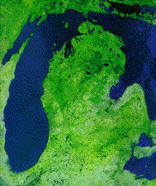
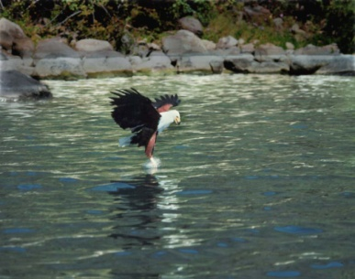
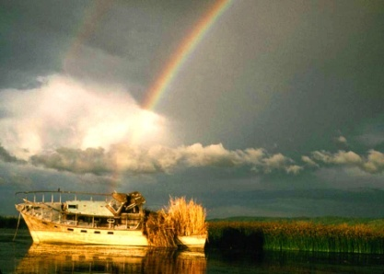
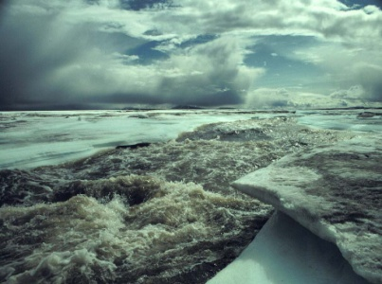
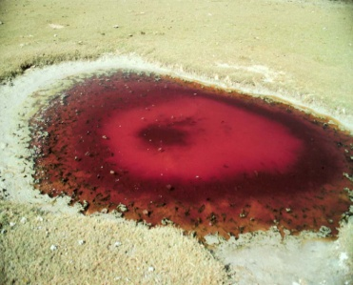
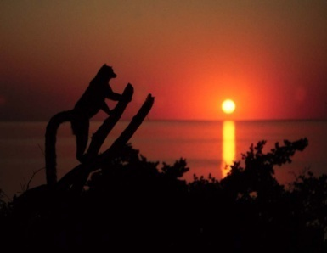
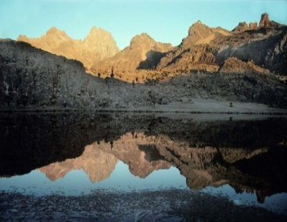
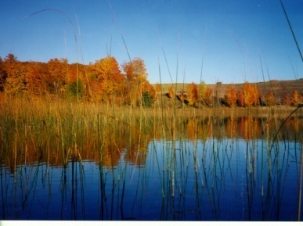
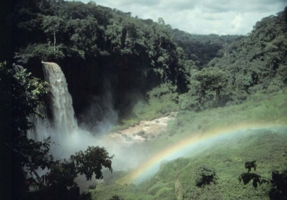
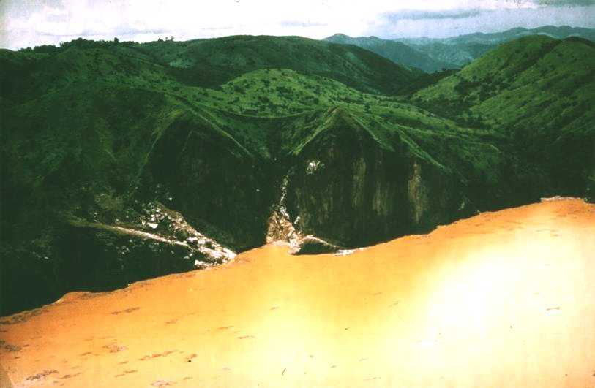
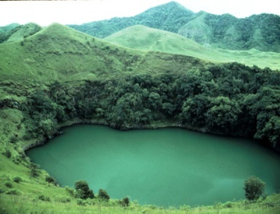
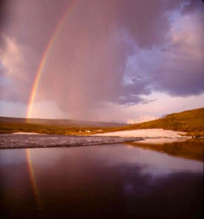
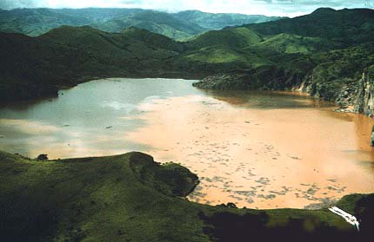
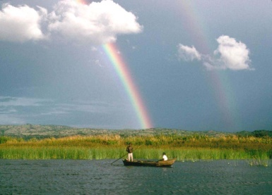
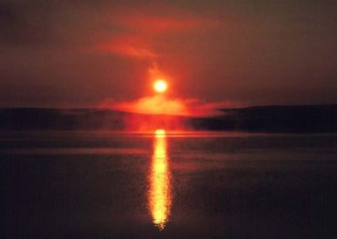
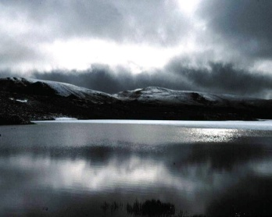
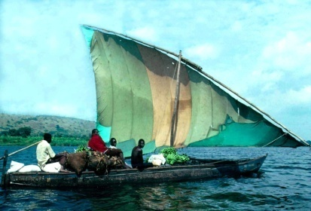
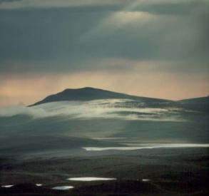
George Kling
Dept. of Ecology &
Evolutionary Biology
1041 Natural Sciences Bldg
Office hours, F 3-4
Teaching:
Global Change (Bio 110)
Ecosystem Ecology (EEB 476)
Limnology (study of lakes; EEB 483)
Research:
Aquatic Ecosystems
Impacts of Climate Change
Biogeochemistry
- Arctic, Africa, Michigan

Slide 20
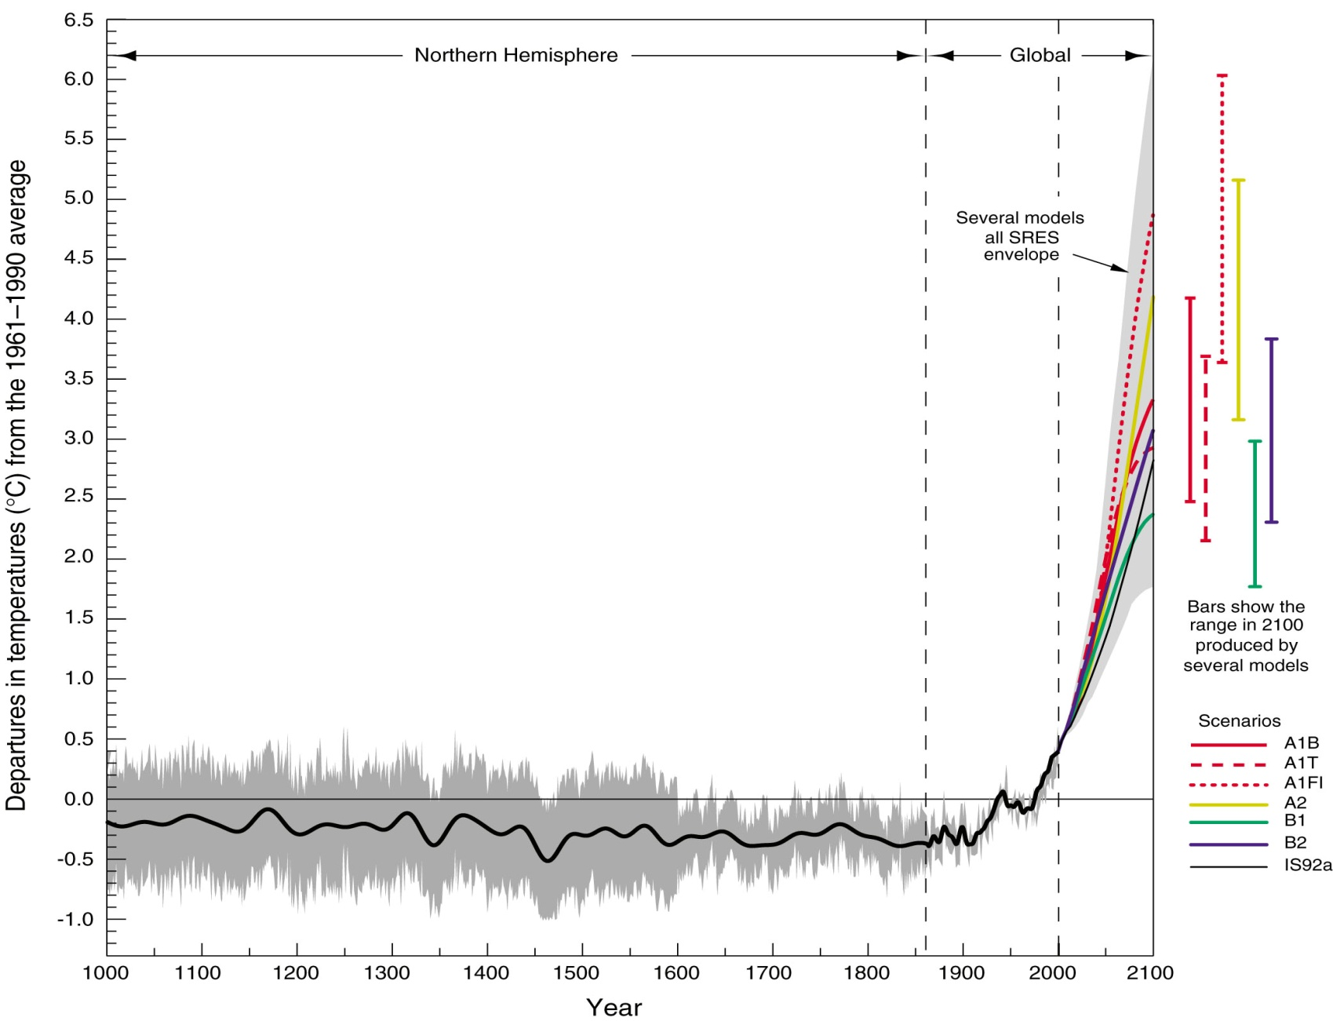
Climate Change – This is your future…
Source: IPCC TAR 2001
Notes:
Highlight that we are going to be talking about why this has happened – squiggly lines in the past, why?
* ASK THEM if they believe that it is real, and that humans are the cause – hope to reverse the show of hands, or, help everyone to decide (this is not a philosophy class – we don’t argue over “facts”).
Variations of the Earth’s Surface Temperature: 1000 to 2100
The projected temperature changes from 2000 to 2100 for the 6 illustrative SRES scenarios are shown in comparison to temperatures observed over the last millennium.
The “several models all SRES envelope” shows the temperature rise for the simple model when tuned to a number of complex models with a range of climate sensitivities. All SRES envelopes refer to the full range of 35 SRES scenarios.

Slide 21
My Themes
Global change on our planet can only be understood by combining “abiotic” and “biotic” components – must look at the whole Ecosystem
A combination of facts and scientific concepts can help us understand even the most complicated problems
Science is NOT hard, and everyone can and MUST learn enough to make rational decisions about our world’s future
Notes:
At the end, talk about the tyranny of classrooms in that you learn what the prof wants you to learn, not what you want to learn. So we have projects to compensate for that, and they are actually a large part of your lab grade.

Slide 22
Possible Projects
The “missing sink” - Where did all the CO₂ go?
Microbes rule, Humans drool
Does the rainforest really matter?
The day the Earth turned brown and blue – The limits to food production
Who’s doing who? Climate skeptics and the use and misuse of Science facts
Who needs more ice? Melting the Earth’s glaciers (a.k.a. “Water World 2050”, starring B. van der Pluijm as K. Costner…)
WWF Climate 2007 “rage in the cage” – People vs. Nature
Abrupt climate change – can El Nino’s run wild?
Whatcha gonna do when the rain don’t come – Shifts in the Global water cycle
Notes:
Ask if this roadmap has helped people to understand where the class is headed and what to expect. Ask who thinks it hasn’t helped, or is still “complicated”. There will be some, and that is to be expected because there are 3 professors and the downside is that each one has a different style. But the upside is that you will never get this experience again with 3 profs in one class, and in fact this is probably the best way of doing it because you sort of get the “best of” album from each of them. Face it, most profs don’t have enough insight about the world to last a full semester – I’ve given you all my secrets just today, in one class! Sure there is more depth in all of it, but, the general tools that I use in my professional life you now know. It is relatively simple, really, and yet it has kept me in beer and chips for quite a while…

Slide 23
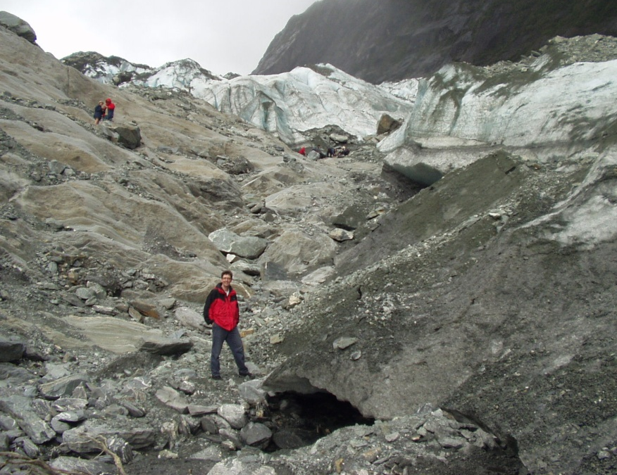
Ben van der Pluijm
Professor of Geological Sciences
Professor of the Environment
(Director Global Change Program)
www.globalchange.umich.edu/Ben
vdpluijm@umich.edu or globalchange@umich.edu
Research: Structural Geology
field areas: the northern Appalachians, the USA continental interior, North and South America’s Grenville, northern Spain’s Cantabria, East African Rift, US-Canadian Rockies, San Andreas (CA) and Alpine (NZ) faults.
topical areas: brittle and ductile faults, deep-crustal architecture, fault gouge and pseudotachylyte, intraplate stresses, oroclines, clay microstructures and textures, magnetic anisotropy, X-ray goniometry, paleomagnetism, geochronology, physical oceanography
Teaching
Interdisciplinary undergraduate teaching (Global Change), Environmental Geology, concentrator and graduate level specialty classes, IT-supported classroom education (GeoPocket), IT-supported field-based education (GeoPad).
Notes:
Franz Josef glacier in NZ

Slide 24
Meet the 4 GSIs (Sections 2-9)

Slide 25
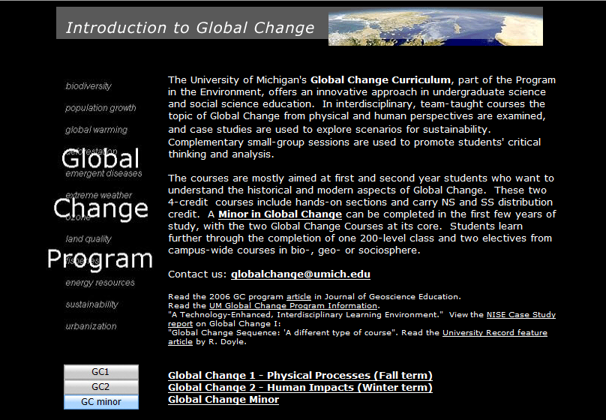
Global Change Curriculum and Minor
http://www.globalchange.umich.edu/

Slide 26
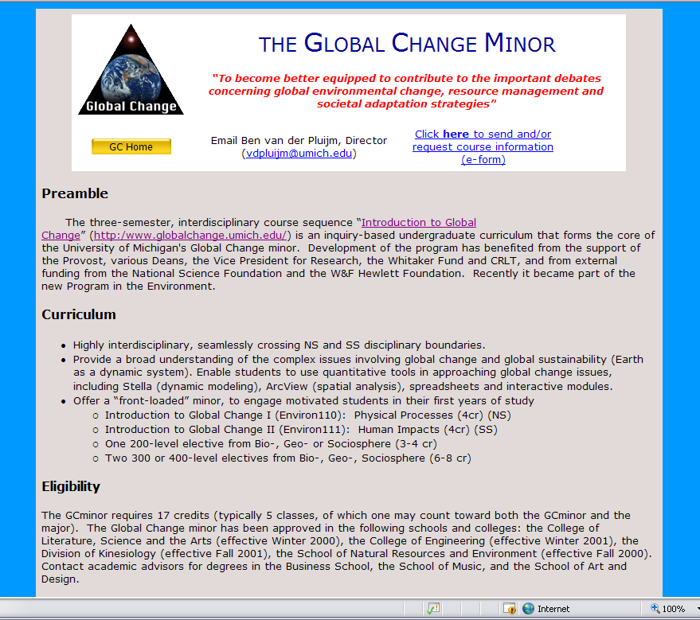

Slide 27
Wrapping up
Global Change encompasses all the ways that our planet has been changing since its formation ~4.5 billion years ago to today, and looking toward the future.
Humans are affecting Earth and its life support systems at an unprecedented rate, which poses new challenges to humankind and our planet.
Decisions and good policy require good science.
…. that is why you are in Global Change !

