Slide 1
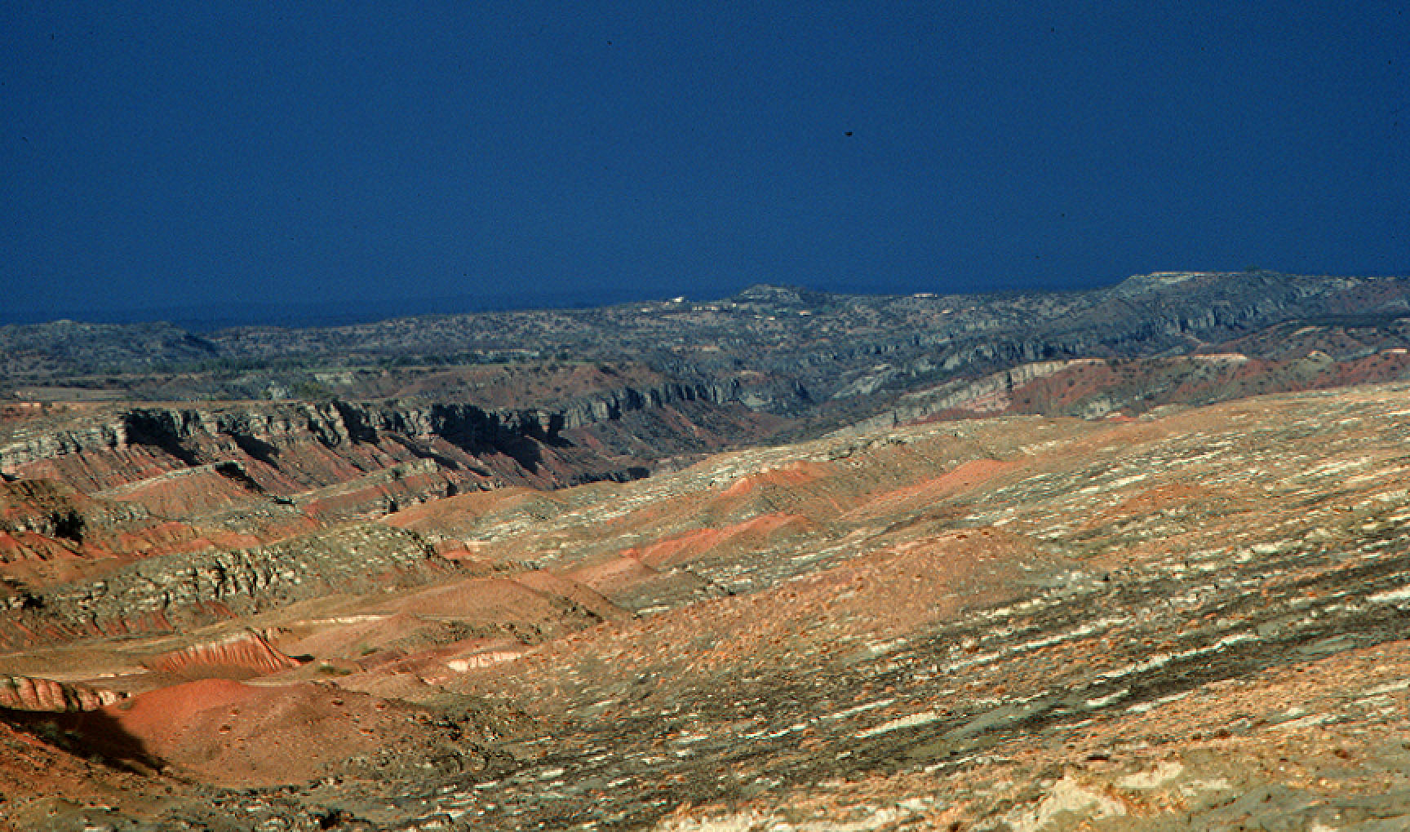
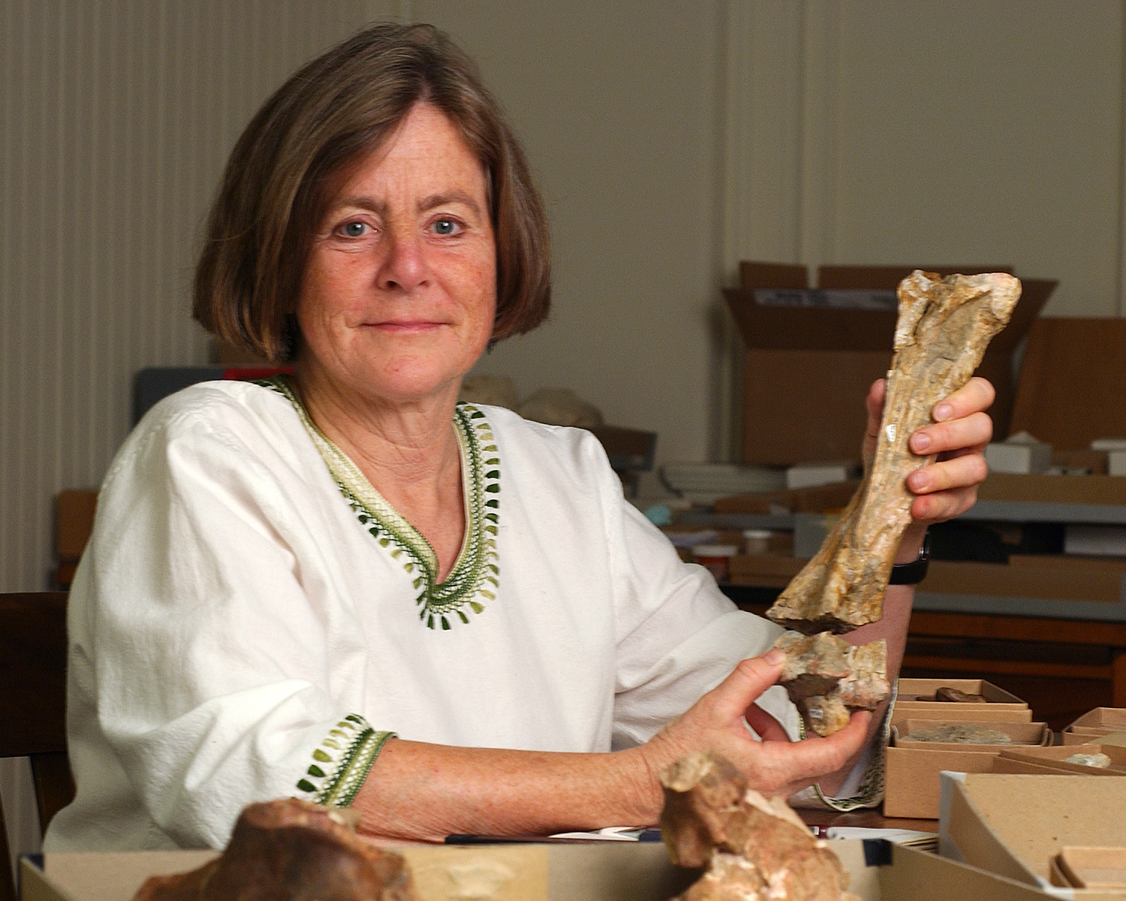
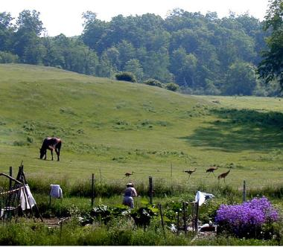
Catherine Badgley
Research
Fossil record of mammals
How mammals respond to climate over deep time
Impact of agriculture on biodiversity Sustainable agriculture
Teaching
Global Change I (Environ/Bio 110) Darwin play (RCIDIV 351)
Food, land, and society (RCIDIV/Environ/EEB 318)

Slide 2
My themes
What processes are responsible for the diversity of life? Evolution, natural selection, species formation
In what ways does the physical world influence living systems? Earth history and diversification, extinction, climate and life
What are the major ways that organisms interact within ecological communities? Competition, predation, mutualism
How have human activities affected all of this and what is at stake? Habitat transformation, endangered species and communities

Slide 3
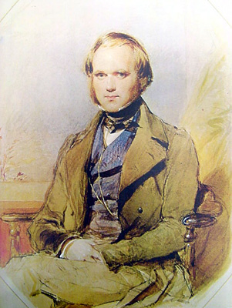
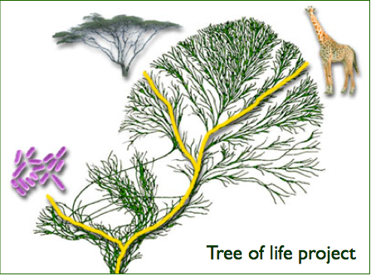
Evolution
3 ideas
Variation + differential survival and reproduction → change in traits over time.
Change in traits + geographic separation → formation of new species.
All species are related by descent from common ancestor.

Slide 4
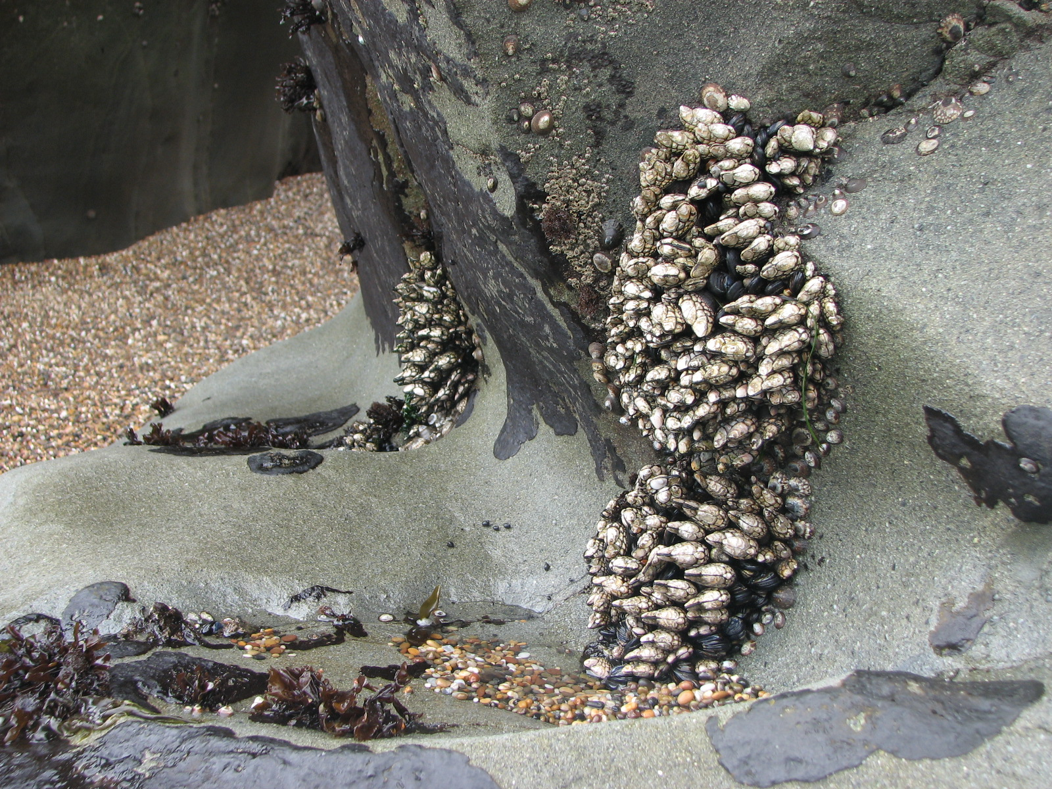
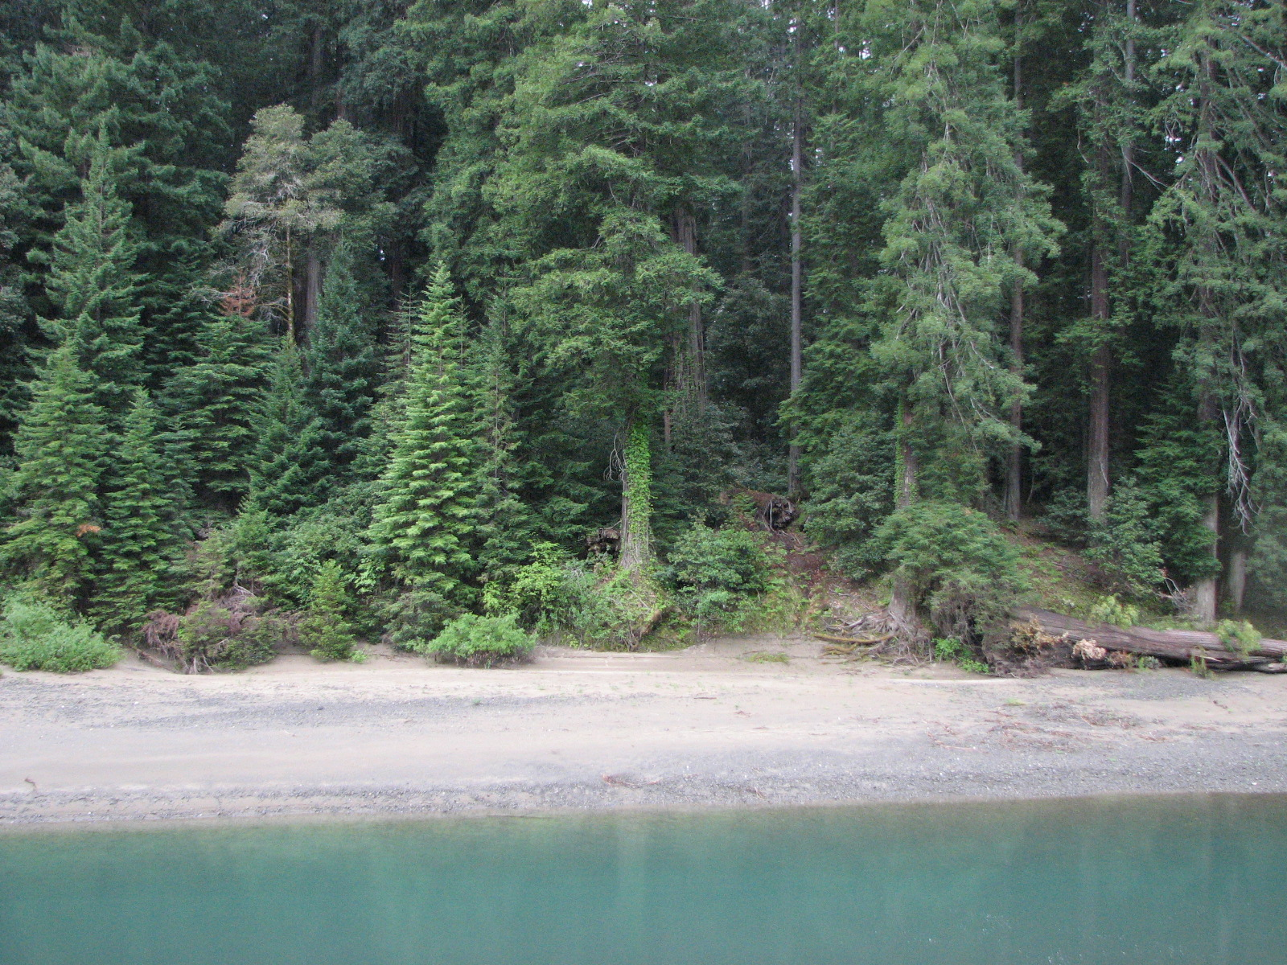
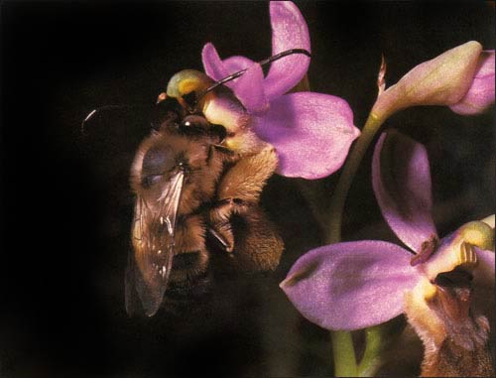
Ecology
Biological diversity depends on physical world for energy and habitats.
All species participate in local and global cycles of nutrients.
Species interactions are the basis for collaboration and competition for life’s essential resources.

Slide 5
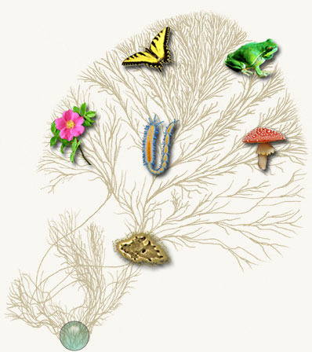
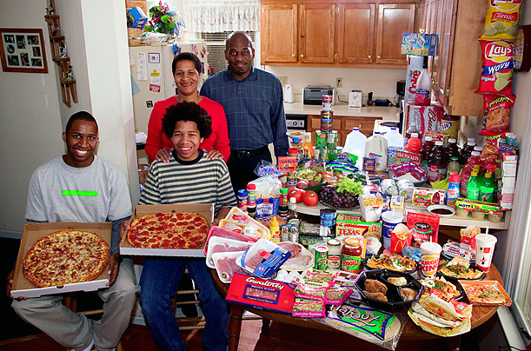
Relationship and Interdependence
Menzel and D’Alusio, Hungry Planet
http://tolweb.org/tree/phylogeny.html

