Slide 1

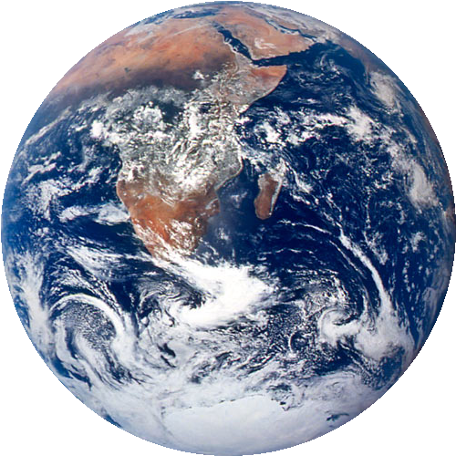

Moving Toward a Less Consumptive Economy
Michael Renner
State of the World 2004
Notes:
Image of globe: NASA (http://eol.jsc.nasa.gov/sseop/clickmap/)
Background image: Free Foto (http://www.freefoto.com/index.jsp)

Slide 2



Moving Toward a Less Consumptive Economy
Overview:
Consumption as a Way of Life
Government Toolbox
Lean and Clean
Take It Back!
Rethinking Products and Services
Public Consumption and Sustainable Credit
Escaping the Work-and-Spend Trap
New Dynamics and Values
Notes:
Image: MorgueFile (http://www.morguefile.com/)

Slide 3
Consumption as a Way of Life
“Our enormously productive economy… demands that we make consumption a way of life… We need things consumed, burned up, worn out, replaced, and discarded at an ever-increasing rate”
- U.S. marketing analyst Victor Lebow, in 1950

Slide 4
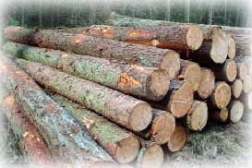
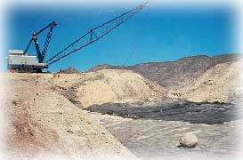
Consumption as a Way of Life
Modern economies can produce huge quantities of goods at very low cost, BUT
- cheap raw materials do not reflect true cost of extracting resources (fuels, minerals, timber, etc.)
- workers in developing world are paid extremely low wages that have fallen below subsistence
Notes:
Left image: Free Foto (http://www.freefoto.com/index.jsp)
Right image: US Fish & Wildlife Service (http://images.fws.gov/)

Slide 5
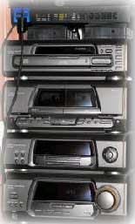

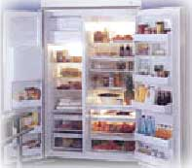
Consumption as a Way of Life
Global consumer class consists of 1.7 billion people… and growing
Planet cannot bear the burden of everyone in the developing world owning as many consumer goods as Americans, Europeans or Japanese
Notes:
Left image: from original “Making Better Energy Choices” PowerPoint presentation given to me
Middle image: from original “Making Better Energy Choices” PowerPoint presentation given to me
Right image: Stock.xchng (http://www.sxc.hu/)

Slide 6

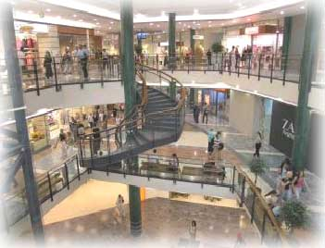
Consumption as a Way of Life
Current model of endless economic growth driven by unbridled consumption not sustainable
Mass-production, mass-consumption, and mass-disposal inevitably lead to
- depletion of resources
- spreading of dangerous pollutants
- undermining of ecosystems
- disruption of planet’s climatic balance
Notes:
Image 1: Stock.xchng (http://www.sxc.hu/)
Image 2: Stock.xchng (http://www.sxc.hu/)

Slide 7
Government’s Toolbox
To achieve sustainability, environmental protection, and social equity, we must move toward a less consumptive economy
Governments can make use of a number of tools to facilitate the transition
Notes:
Image: ClipArt

Slide 8
Estimates of Global Environmentally Harmful Subsidies
Government’s Toolbox
Subsidy phaseouts
  - Government subsidies allow the prices of resources to be far lower than they would otherwise be, encouraging greater consumption
Road transportation
400
Agriculture
260
Fossil fuels, Nuclear energy
100
Water
50
Fisheries
25
Total: $849 billion
Forestry
14
Billion Dollars
Source: Myers and Kent (2001)

Slide 9
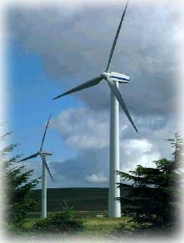

Government’s Toolbox
Destructive subsidies should be phased out and a portion of these funds should be shifted to
    - renewable energy
    - efficiency technologies
    - clean-production methods
    - public transit
Notes:
Left image: from original “Making Better Energy Choices” PowerPoint presentation given to me
Right image: Free Foto (http://www.freefoto.com/index.jsp)

Slide 10
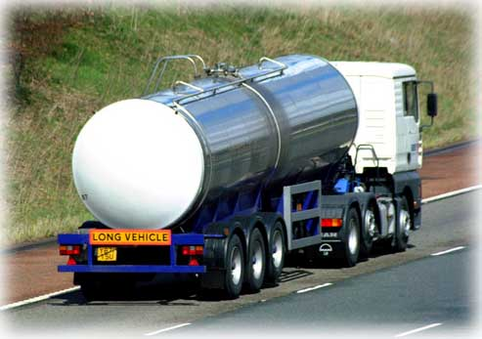
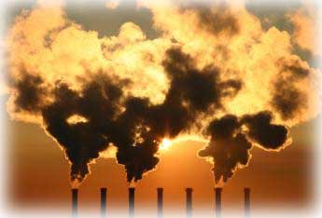
Government’s Toolbox
2) Environmental tax shifting
  - By taxing carbon emissions, nonrenewable energy, virgin materials, landfills, and other forms of waste and pollution, market prices would reflect the full environmental costs of economic activities
Notes:
Left image: Free Foto (http://www.freefoto.com/index.jsp)
Right image: Stock.xchng (http://www.sxc.hu/)

Slide 11
Government’s Toolbox
Revenues from green taxes could lighten the tax burden now falling on labour, encouraging job creation
Environmental Tax Revenue, EU
6.5 %
237.7
% of all taxes and social contributions
Billion Euros
6.2 %
130.4
5.8 %
54.6
Year
Source: OECD

Slide 12

Government’s Toolbox
3) Procurement
  - From the federal to the local level, governments in industrial countries spend trillions of dollars on public purchases every year
  - By buying environmentally preferable products, governments can influence
    - how products are designed
    - how efficiently they function
    - how long they last
    - whether they are handled responsibly at the end of their useful lives
Notes:
Image: MorgueFile (http://www.morguefile.com/)

Slide 13
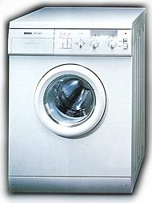
Government’s Toolbox
4) Product Standards
  Governments can impose national standards to save energy and water, such as household appliance efficiency programs
- These regulations require manufacturers to meet minimum requirements
Notes:
Image: Tufts Climate Initiative (http://www.tufts.edu/tie/tci/TakeAction.html)

Slide 14

Government’s Toolbox
5) Ecolabeling Programs
  Ecolabels provide consumers with the requisite information to make responsible purchasing decisions
  Labeling schemes have been developed for many products, including appliances, electricity, wood, and agricultural products
  Ecolabels encourage manufacturers to design and market more eco-friendly products
Notes:
Image: EPA (www.epa.gov/ )

Slide 15
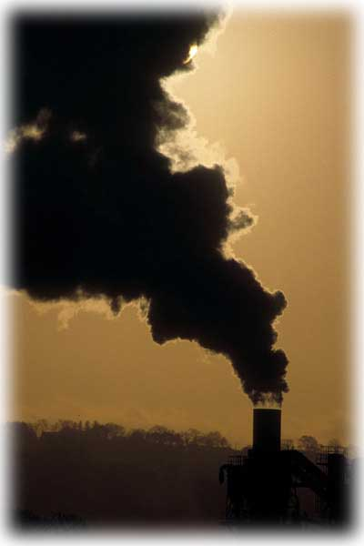
Lean and Clean
Industrial economies mobilize enormous quantities of fuels, metals, minerals, construction materials, and forestry and agricultural raw materials
Most material flows never actually pass through the hands of any consumer and serve no purpose whatsoever
These “hidden flows” include
  waste materials from mining and other industries
  dredging materials
  carbon dioxide and other emissions
Notes:
Image: Free Foto (http://www.freefoto.com/index.jsp)

Slide 16
Lean and Clean
Given broadly comparable living standards between the U.S., Germany, and Japan, the U.S. economy could stand to be leaner
Material Requirements Per Person (1996)
86
Domestic output for consumption
Hidden Flows
Tons
62
43
21
30
10
United States
Germany
Japan
Source: Matthews et al. (2000)

Slide 17

Lean and Clean
To shrink hidden flows, destructive activities need to be downsized by
  improving energy and materials efficiency
  boosting recycling and reuse
  lengthening the useful lifetime of products
Another approach is to reduce the environmental impact of goods and services delivered to consumers
Notes:
Image: from ClipArt

Slide 18
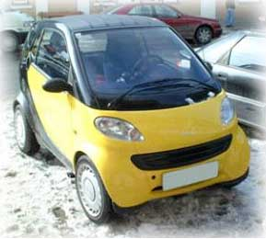

Reducing the Environmental Impact of Products
Dematerialization
- Reducing the amount of raw materials needed to create products (i.e., lighter cars, thinner paper) and cutting the amount of energy needed to operate them
Clean Production
- Reducing the reliance on toxic materials in manufacturing, preventing air and water pollution, and avoiding hazardous waste generation
Notes:
Image 1: from original “Making Better Energy Choices” PowerPoint presentation given to me
Image 2: Free Foto (http://www.freefoto.com/index.jsp)

Slide 19

Reducing the Environmental Impact of Products
“Zero-waste” closed-loop systems
Conventional system is “cradle-to-grave”: after raw materials are extracted and processed, leftover substances become unwanted waste
Alternative system is “cradle-to-cradle”: the byproducts and waste from one factory become the feedstock of another
Modeled after the regenerative cycles of nature, cradle-to-cradle materials circulate in closed-loop cycles, providing nutrients for nature or industry
Notes:
Image: MorgueFile (http://www.morguefile.com/)

Slide 20
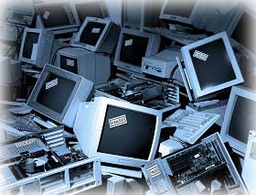
Take It Back!
Extended Producer Responsibility (EPR) Laws
  Require companies to take back products after their useful life
  The goal is to induce manufacturers to
  eliminate unnecessary parts
  forgo unneeded packaging
  design products that can easily be disassembled, recycled, remanufactured, or reused
Notes:
Image from original “Making Better Energy Choices” PowerPoint presentation given to me

Slide 21

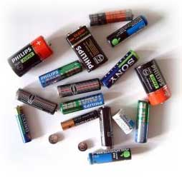
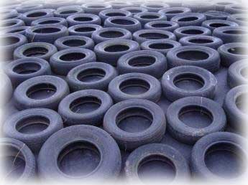
Take It Back!
Several countries in Europe, Asia, and Latin America have implemented EPR legislation for a wide range of products, including
  packaging
  electric and electronic equipment
  vehicles
  tires
  batteries
  office machinery
Notes:
All images: Stock.xchng (http://www.sxc.hu/)

Slide 22
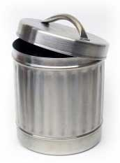
Rethinking Products and Services
Many consumer products are intended to be throwaways – repair and replacement of parts is often impossible
Merchandise should be designed and manufactured to be durable, repairable, and upgradeable
By working to extend useful product life, companies can squeeze better performance out of the resources embedded in their goods
Notes:
Image: Stock.xchng (http://www.sxc.hu/)

Slide 23
Rethinking Products and Services
Recycling and remanufacturing keep materials out of landfills and incinerators, and save energy
Energy Savings Gained by Switching from Primary Production to Secondary Materials
Aluminum
95%
Copper
85%
Plastics
80%
Steel
74%
Lead
65%
Paper
64%
Percent Savings
Source: Bureau of International Recycling

Slide 24
Rethinking Products and Services
A new business model: quality retail
Instead of merely selling goods, manufacturers would retain ownership, and lease or rent products
Manufacturers would remain responsible for their products and provide service to their customers by advising them on
- upkeep of products
- how to extend usefulness with the least amount of energy and materials use
- upgrades and other changes
Notes:
Image: MorgueFile (http://www.morguefile.com/)

Slide 25
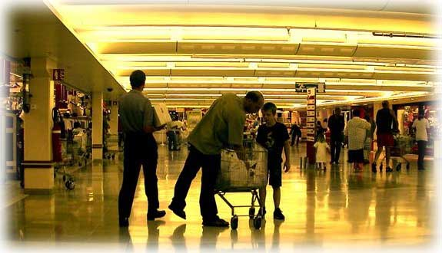
Public Consumption and Sustainable Credit
Improving consumption patterns is not enough, moderation in overall consumption is required
Several measures can be taken to discourage excessive consumption
Notes:
Image: MorgueFile (http://www.morguefile.com/)

Slide 26

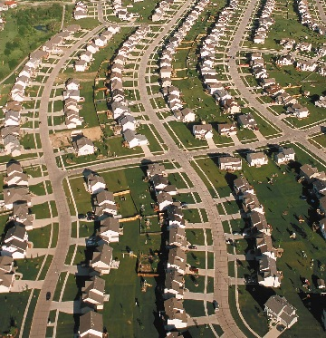
Reducing Excessive Consumption
Public vs Private Consumption
- organized sharing reduces multiplication of goods on a grand scale (i.e., car-sharing programs, community tool-sharing arrangements)
Overcoming “Infrastructure of Consumption”
- current infrastructure makes environmental choices difficult, if not impossible (e.g., sprawling, car-oriented settlement patterns discourage walking or biking)
Notes:
Image 1: Stock.xchng (http://www.sxc.hu/)
Image 2: NCRS (http://photogallery.nrcs.usda.gov/)

Slide 27

Reducing Excessive Consumption
Tackling Consumer Credit
- advertising and the easy availability of credit cards compel people to make purchases beyond their means
- U.S. consumers’ debts are now growing twice as fast as their incomes
Feebates
$
- governments could offer tax rebates for environmentally- benign products, while taxing those that fall below standards
Notes:
Image: Free Foto (http://www.freefoto.com/index.jsp)

Slide 28
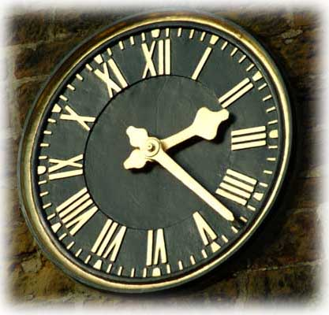
Escaping the Work-and-Spend Trap
Greater disposable income translates into greater consumer purchases
Benefits associated with reducing work hours, and trading income for time:
  - increase in quality of life
  - creation of more jobs
Americans are working increasingly longer hours, while Europeans enjoy more leisure time, due to “time credit” systems, paid leaves, and job rotation schemes
Notes:
Image: Free Foto (http://www.freefoto.com/index.jsp)

Slide 29

New Dynamics and Values
To move toward a less consumptive economy, we must abandon the outdated assumption that quantitative growth is unconditionally desirable, and instead embrace the notion of qualitative growth
Notes:
Image: Stock.xchng (http://www.sxc.hu/)

Slide 30
New Dynamics and Values
In a sustainable economy, corporate revenues and profits would be associated with deriving the most service and best performance out of a product, minimizing energy and materials consumption, and maximizing quality
Notes:
Image: Stock.xchng (http://www.sxc.hu/)

Slide 31
About the Author
Michael Renner is a Senior Researcher at the Worldwatch Institute and Director of the Institute’s Global Security Project

Slide 32
More information on
State of the World 2004
at www.worldwatch.org

